Slide 1
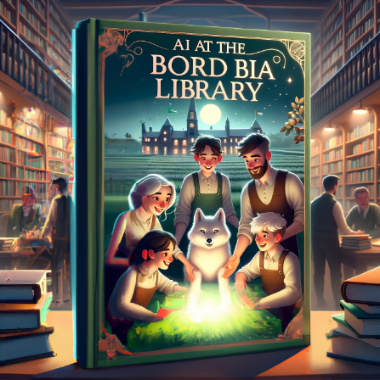
Mairéad McKeown
Lauren Sneyd

Slide 2

Our Vision
Customers around the globe recognise that Irish food and drink is world-class; that it is high quality, distinctive, and made by a diverse range of creative producers from a unique and fortuitous island location.
Our Purpose
Our purpose is to bring Ireland’s outstanding food, drink and horticulture to the world, thus enabling growth and sustainability of producers.
Notes:
Our Vision - Customers around the globe recognise that Irish food and drink is world-class; that it is high quality, distinctive, and made by a diverse range of creative producers from a unique and fortuitous island location.
Our Purpose - Our purpose is to bring Ireland’s outstanding food, drink and horticulture to the world, thus enabling growth and sustainability of producers.

Slide 3



Bord Bia - The Irish Food Board was established by an act of the Irish parliament (the Dáil) on 1 December 1994. It brought together the former CBF (Córas Beostoic agus Feola - the Irish Meat and Livestock Board) and the food promotion activities of An Bord Tráchtála/the Irish Trade Board.
In July 2004 responsibility for the development of the horticultural industry in Ireland, formerly Bord Glas, was integrated into Bord Bia.
On the 1 June 2009 the responsibility for seafood promotion in domestic and international markets was transferred from BIM (Bord Iascaigh Mhara) to Bord Bia.
Headquartered in Dublin, Bord Bia supports the national and international ambitions of Irish food, drink and horticulture businesses through its highly focused organisational structure and its network of offices in EMEA, Asia and the USA.
Notes:
About Us - Bord Bia/Irish Food Board was established by an act of the Irish parliament (the Dáil) on 1 December 1994. It brought together the former CBF (Córas Beostoic agus Feola - the Irish Meat and Livestock Board) and the food promotion activities of An Bord Tráchtála/the Irish Trade Board, now part of Enterprise Ireland.
In July 2004 responsibility for the development of the horticultural industry in Ireland, which rested with the former Bord Glas, was integrated into Bord Bia.
On the 1 June 2009 the responsibility for seafood promotion in domestic and international markets was transferred from BIM (Bord Iascaigh Mhara) to Bord Bia.
Headquartered in Dublin, Bord Bia supports the national and international ambitions of Irish food, drink and horticulture businesses through its highly focused organisational structure and its network of offices in EMEA, Asia and the USA.

Slide 4
Mairéad McKeown
Lauren Sneyd

Slide 5

Chapters
We’re proud champions of Ireland’s Farmers and Producers
But disruptive forces demand we take a new approach
We can be a catalyst that helps our industry learn, know and sustainably grow
By shifting our focus we can have greater impact
And together making it happen
We’ll be agents of a thriving future for Irish food, drink & horticulture
Notes:
Chapter 1-6 are:

Slide 6
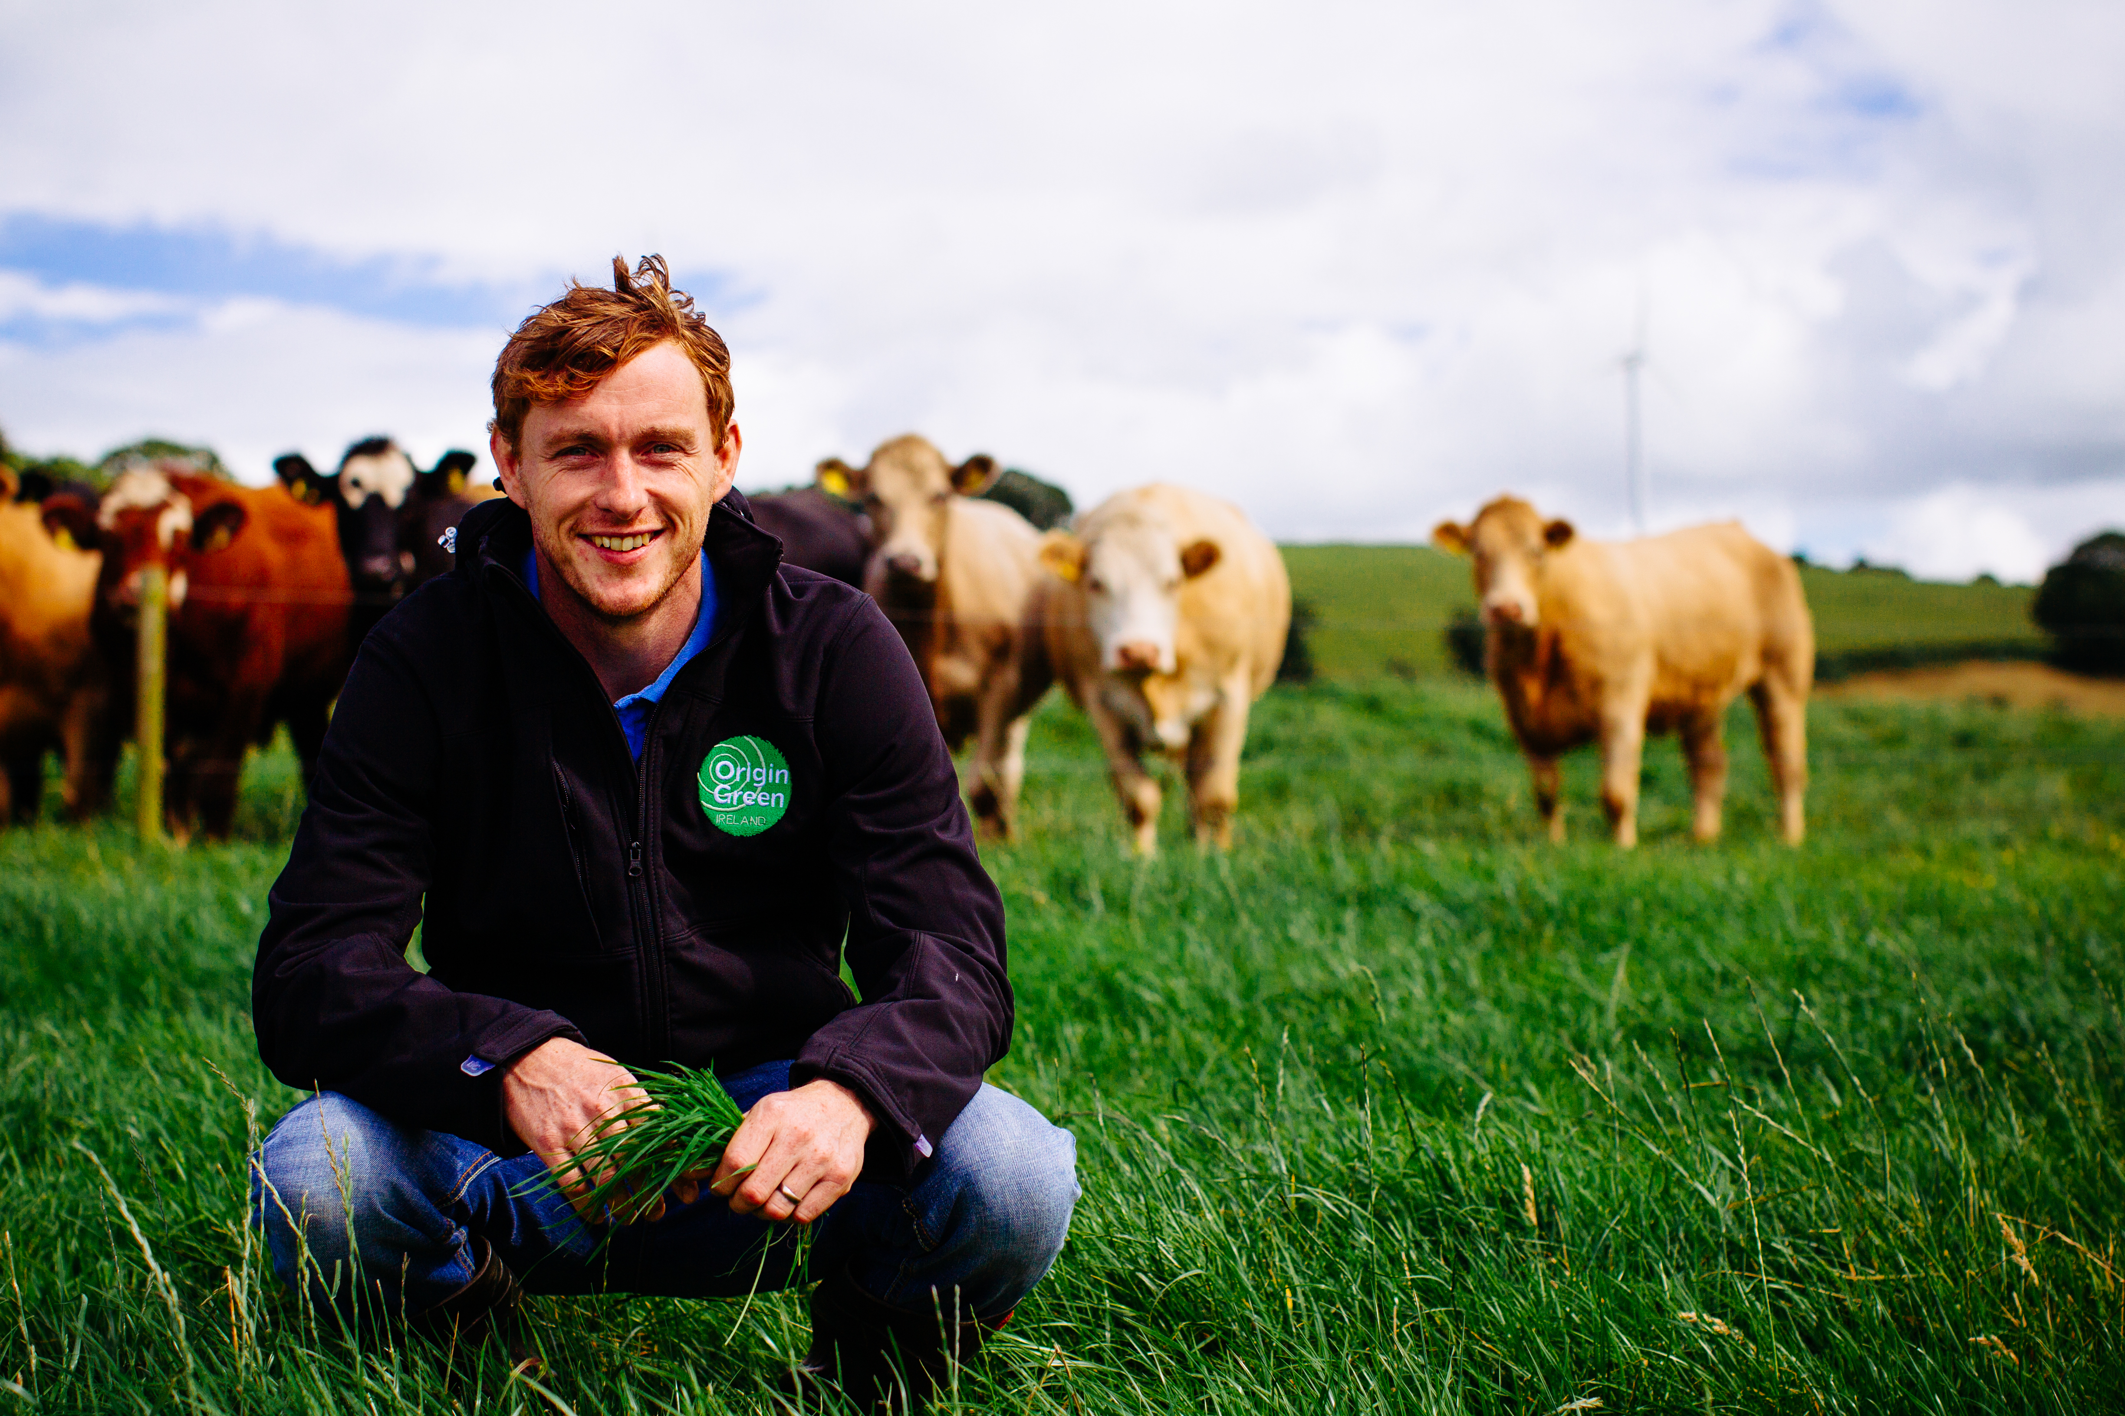

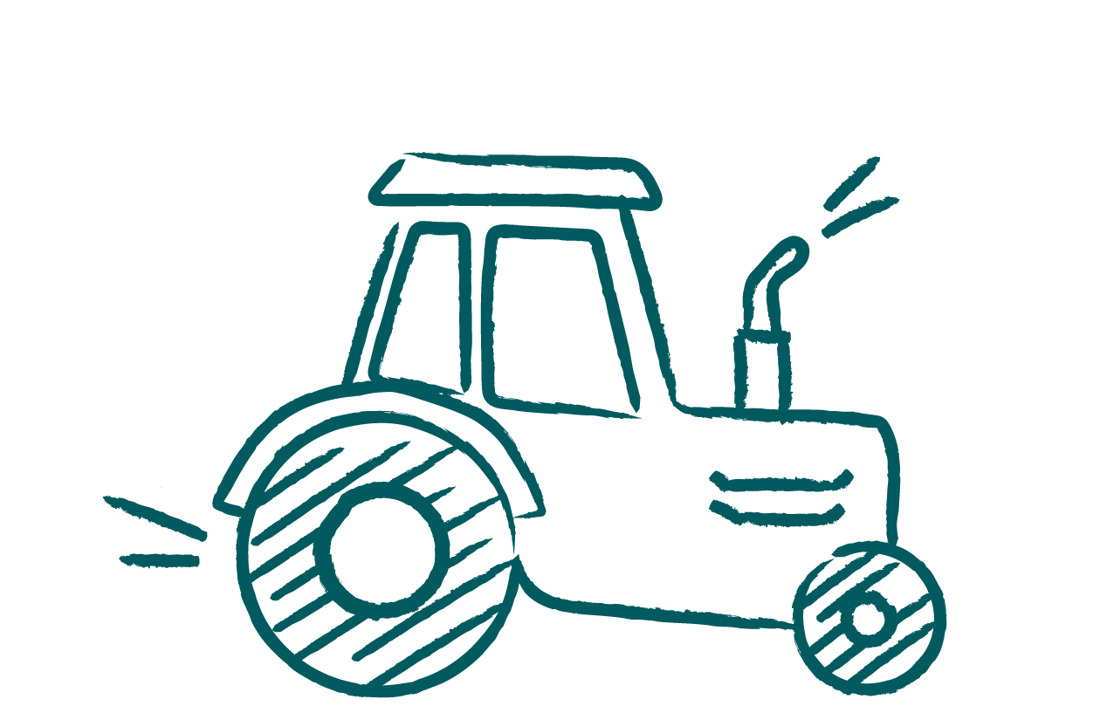
Chapter 1
We’re proud champions of Ireland’s Farmers and Producers
Notes:
We’re proud champions of Ireland’s Farmers and Producers

Slide 7

Known for our knowledge, we’re the trusted thread that connects our colleagues and producers to ideas and insights that help them get closer to consumers and customers across the globe.
Notes:
Known for our knowledge, we’re the trusted thread that connects our colleagues and producers to ideas and insights that help them get closer to consumers and customers across the globe.

Slide 8


Our expertise has empowered and enabled our industry to navigate the ever-changing business landscape with clarity and confidence.
Notes:
Our expertise has empowered and enabled our industry to navigate the ever-changing business landscape with clarity and confidence.

Slide 9



We’ve curated a world-class collection and set the standard for impactful library engagements and instruction.
Notes:
We’ve curated a world-class collection and set the standard for impactful library engagements.

Slide 10

We’re lifelong learners, every one of us aware that our skills and abilities are not fixed, each and every day we come to work to bring Ireland’s outstanding food, drink & horticulture to the world.
Notes:
We’re lifelong learners, every one of us aware that our skills and abilities are not fixed, each and every day we come to work to bring Ireland’s outstanding food, drink & horticulture to the world.

Slide 11


Chapter 2
But disruptive forces demand we take a new approach
Notes:
But disruptive forces demand we take a new approach

Slide 12

AI is permeating our culture and disrupting how we operate, but disruption is not new to us, Librarians have been adapting to disruptive forces for centuries, card to digital catalogue, encyclopedia to search engine, print to eBooks…..
12
Notes:
AI is permeating our culture and disrupting how we operate, but disruption is not new to us, Librarians have been adapting to disruptive forces for centuries, card to digital catalogue, encyclopaedia to search engine, print to eBooks…..

Slide 13

The bell has rung, and AI brings many great opportunities that will fundamentally change how we work. It can help us benefit from the reduction the of time spent on mundane and repetitive tasks, easier sense making of data, positive enhancements to access to information and knowledge…… (IFLA, 2023)
Notes:
The bell has rung, and AI brings many great opportunities that will fundamentally change how we work. It can help us benefit from the reduction the of time spent on mundane and repetitive tasks, easier sense making of data, positive enhancements to access to information and knowledge……
(IFLA, 2023)

Slide 14

BUT, like any great opportunity maker, AI certainly is not without its challenges: it’s generating new content based on past values and we simply can’t and won’t escape hallucinations, bias, information that’s hard to evaluate, increased risks to privacy, corporate governance and copyright..
Notes:
BUT, like any great opportunity maker, AI certainly is not without its challenges: it’s generating new content based on past values and we simply can’t and won’t escape hallucinations, bias, information that’s hard to evaluate, increased risks to privacy, corporate governance and copyright..

Slide 15

Rather than fear this howling wolf and get left behind, we’ve decided to do what we do best, learn all we can about it and adapt. So that we can carefully and competently work together to implement the benefits, understand the challenges and share that learning with our industry (McGettigan, 2023).
Notes:
And rather than fear this howling wolf and get left behind, we’ve decided to do what we do best, learn all we can about it and adapt. So that we can carefully and competently work together to implement the benefits, understand the challenges and share that learning with our industry (McGettigan, 2023)

Slide 16

Chapter 3
We can be a catalyst that helps our industry learn, know and sustainably grow
Notes:
We can be a catalyst that helps our industry learn, know and sustainably grow

Slide 17

Amid the disruption of AI, there’s a growing hunger for knowledge about how it works and a thirst for the skills needed to use its tools, technologies and applications effectively.
Notes:
Amid the disruption of AI, there’s a growing hunger for knowledge about how it works and a thirst for the skills needed to use its tools, technologies and applications effectively.

Slide 18

Powered by our curiosity, commitment to learning and specialist expertise we are becoming AI literate and displaying social proof of our newly acquired skills in collaborating and communicating with AI (AI powered: search and discovery, authoring tools), prompting, content generation, technology and tools and ethics. (Shutterstock, 2024)
Notes:
Powered by our curiosity, commitment to learning and specialist expertise we are becoming AI literate and displaying social proof of our newly acquired skills in collaborating and communicating with AI (AI powered: search and discovery, authoring tools, prompting (only detailed language will produce the results you’re looking for, e.g. style, goal, context, expectations, source, role playing, tone), content generation, technology and tools and ethics. (Shutterstock, 2024)
AI literacy refers to “a set of competencies that enables individuals to evaluate AI technologies critically; communicate and collaborate effectively with AI; and use AI as a tool online, at home, and in the workplace” (Long & Magerko, 2020, p.598).

Slide 19

Leveraging our new knowledge, we are building more connected strategic partnerships across our organisation and identifying how to turn opportunities into reality.
Notes:
Leveraging our new knowledge, we are building more connected strategic partnerships across our organisation and identifying how to turn opportunities into reality.

Slide 20

We can be a unifying force that helps unlock sustainable growth for our industry with howling innovations and adaptions to our teaching and learning practice, world-class library collections and information services.
Notes:
We can be a unifying force that helps unlock sustainable growth for our industry with howling innovations and adaptions to our teaching and learning practice, world-class collections and services

Slide 21


Chapter 4
By shifting our focus we can have greater impact
Notes:
By shifting our focus we can have greater impact

Slide 22

Aligning our collections to our strategic Digital Training programme, we are partnering to satisfy our organisations hunger for digital transformation.
5
Notes:
Aligning our collections to our strategic Digital Training programme, we are partnering to satisfy our organisations hunger for digital transformation.

Slide 23
Creating glossaries of AI terminology, we are informing good AI conversations, analysing and synthesizing world class lessons on AI, we are empowering transformative thinking.
Notes:
Creating glossaries of AI terminology, we are informing good AI conversations, analysing and synthesizing world class lessons on AI, we are empowering transformative thinking.

Slide 24
Collaborating with teams across our organisation, we are inspiring and motivating our industry with bite-sized courses to facilitate the learning and development of AI skills, its different use cases and the resulting challenges, opportunities and responsible practice in line with Bord Bia’s robust AI policy.
Notes:
Collaborating with Industry and Organisation Talent and Corporate Governance/ ICT, and Marketing Communications, we are inspiring and motivating our industry with bite-sized courses, that facilitate the learning and development of AI skills, its different use cases in marketing, innovation, research, shopping, farming, education.. and the resulting challenges, opportunities and responsible practice in line with Bord Bia’s robust AI policy.

Slide 25

We are sharing our skills in best practice prompting, and effective communication with AI chatbots, and we are connecting our learners to evergreen soft-skills, ultimately empowering our industry to unleash its creativity and future proof skillsets for the roles of today and tomorrow, in a world of work that is more human than ever before
(Roslansky, 2023).
Notes:
We are sharing our skills in best practice prompting, and effective communication with AI chatbots, and we are connecting our learners to evergreen soft-skills, ultimately empowering our industry to unleash its creativity and future proof skillsets for the roles of today and tomorrow, in a world of work that is more human than ever before (Roslansky, 2023).

Slide 26

Chapter 5
And together making it happen
Notes:
And together making it happen

Slide 27

We’ll achieve greater impact by leveraging our past experience, seeking fresh thinking and using data driven insights to inform our ongoing approach to AI.
Notes:
We’ll achieve greater impact by leveraging our past experience, seeking fresh thinking and using data driven insights to inform our ongoing approach to AI.

Slide 28
We’ll do less better and share learning and knowledge that moves our industry forward, giving us more focus, control and ability to adapt.
5
Notes:
We’ll do less better and share learning and knowledge that moves our industry forward, giving us more focus, control and ability to adapt.

Slide 29

We’ll keep each other fully informed and collaborate and align with purpose and respect to act in unity as One Bord Bia across the world.
Notes:
We’ll keep each other fully informed and collaborate and align with purpose and respect to act in unity as One Bord Bia across the world.

Slide 30
We’ll bring our clients and colleagues with us as we navigate changed realities, explore new possibilities, and practice shared responsibility.
Notes:
We’ll bring our clients and colleagues with us as we navigate changed realities, explore new possibilities, and practice shared responsibility.

Slide 31

Chapter 6
We’ll be agents of a thriving future for Irish food, drink & horticulture
Notes:
We’ll be agents of a thriving future for Irish food, drink & horticulture

Slide 32
Ambitious in striving for excellence and crystal clear in our approach.
Notes:
Ambitious in striving for excellence and crystal clear in our approach.

Slide 33
United as a curious and trusted team, we will keep abreast of AI trends, developments and use cases, collaborate on cross functional groups that test and evaluate new tools that help deliver strategy, facilitate the sharpening of AI and in demand human-centric skills, and use our discovery and practice to help our industry learn, know and sustainably grow in an AI era.
Notes:
United as a curious and trusted team, we will keep abreast of AI trends, developments and use cases, collaborate on cross functional groups that test and evaluate new tools that help deliver strategy, facilitate the sharpening of AI and in demand human-centric skills, and use our discovery and practice to help our industry learn, know and sustainably grow in an AI era.

Slide 34

An indispensable partner in our industry’s continuing commercial success, we will help mitigate risk and empower opportunities through the competent and responsible use of AI.
Notes:
An indispensable partner in our industry’s continuing commercial success, we will help mitigate risk and empower opportunities through the competent and responsible use of AI.

Slide 35
Mairéad and Lauren’s - Top 10 tips on how to learn, know and sustainably grow with AI
Notes:
Mairéad and Lauren’s - Top tips on how to learn, know and sustainably grow with AI

Slide 36
Learn
1. Be a Connected Colleague
Harness your soft skills to work more easily and effectively with others in a human-centric world
Notes:
Be a Connected Colleague
Harness your soft skills to work more easily and effectively with others in a human-centric world

Slide 37
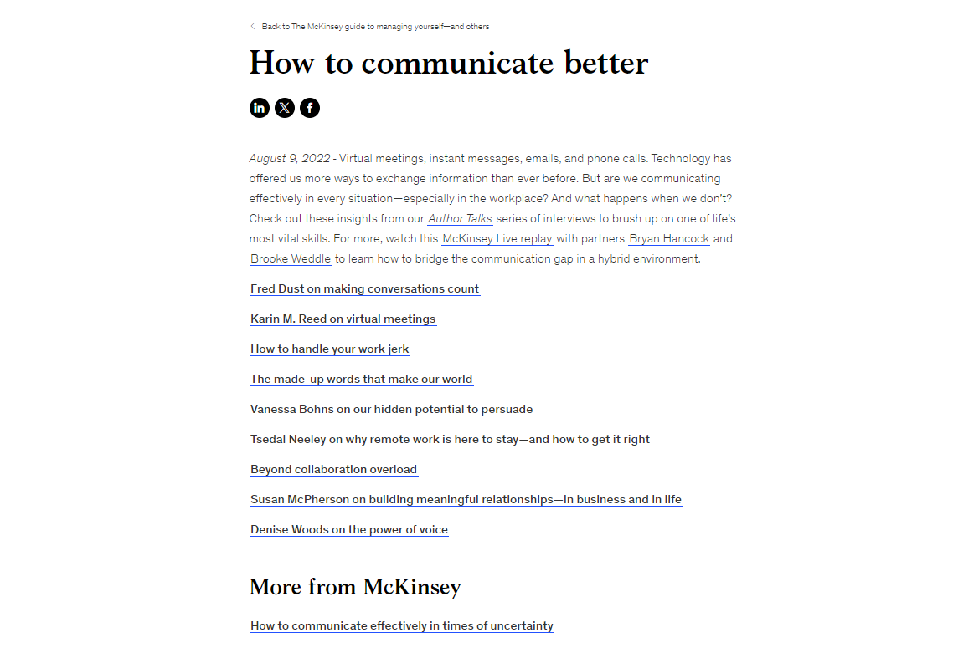
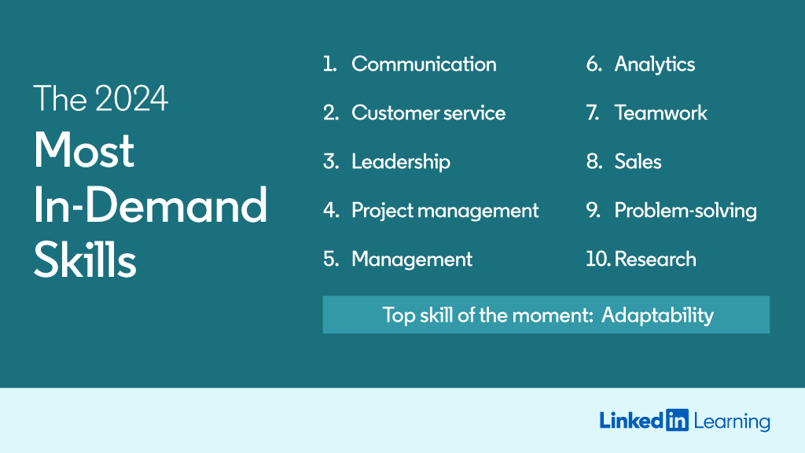
Thought Starter:
How can you develop the most in demand skill (communication) in today’s jobs market? (LinkedIn, 2024) (McKinsey, 2022)
Notes:
How can you develop the most in demand skill (communication) in today’s jobs market? (LinkedIn, 2024) (McKinsey, 2022) https://www.linkedin.com/business/talent/blog/talent-strategy/linkedin-most-in-demand-hard-and-soft-skills
https://www.mckinsey.com/featured-insights/mckinsey-guide-to-managing-yourself/how-to-communicate-better

Slide 38
Learn
2. Be a Lifelong Learner
Upskill and keep upskilling, never stop learning about how to communicate, collaborate and iterate with AI and take the time to post social proof of your development
Notes:
Be a Lifelong Learner
Upskill and keep upskilling, never stop learning about how to communicate, collaborate and iterate with ai and take the time to post social proof of your development.

Slide 39

Thought Starter:
How can you stay ahead of the curve, enhance efficiency, build trust and unlock new opportunities with AI in 2024? (Apollo, 2024)
Notes:
How can you stay ahead of the curve, enhance efficiency, build trust and unlock new opportunities with ai in 2024? (Apollo, 2024)
https://www.linkedin.com/pulse/conquer-ai-2024-5-free-courses-apolloitservices-quswc/

Slide 40
Learn
3. Be an Adaptable Instructor
Be practical and leverage your existing skills, you don’t always have to reinvent the wheel, info lit meets AI lit
Notes:
Be an Adaptable Instructor
Be practical and leverage your existing skills, you don’t always have to reinvent the wheel, info lit meets AI lit

Slide 41
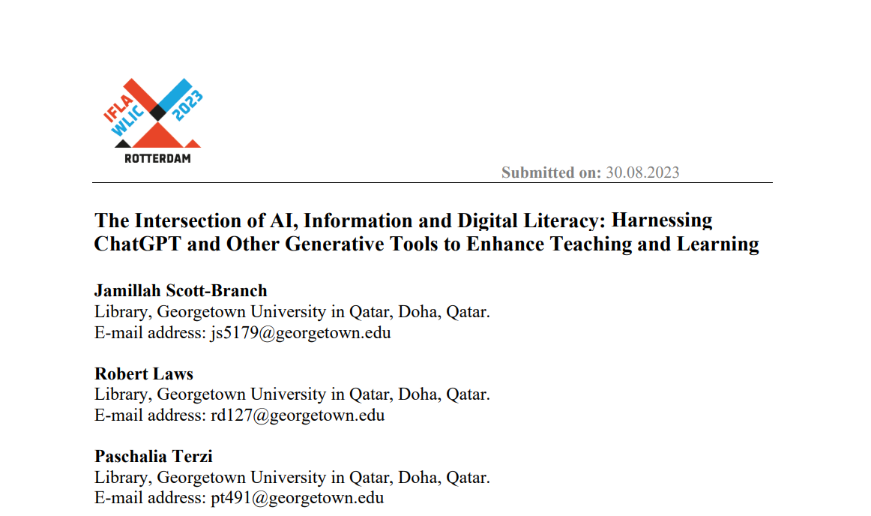
Thought Starter:
How can you harness ChatGPT and Other Generative Tools to Enhance your Teaching and Learning practice? (Scott et al, 2023)
Notes:
How can you harness ChatGPT and Other Generative Tools to Enhance your Teaching and Learning practice? (Scott et al, 2023)
https://repository.ifla.org/bitstream/123456789/2788/1/112-scott-en.pdf

Slide 42

Know
4. Be a Compliant Practitioner
Align everything you do with AI, to your organisation’s AI policy always ensuring ethical and responsible use
Notes:
Be a Compliant Practitioner
Align everything you do with AI, to your organisations AI policy always ensuring ethical and responsible use.

Slide 43
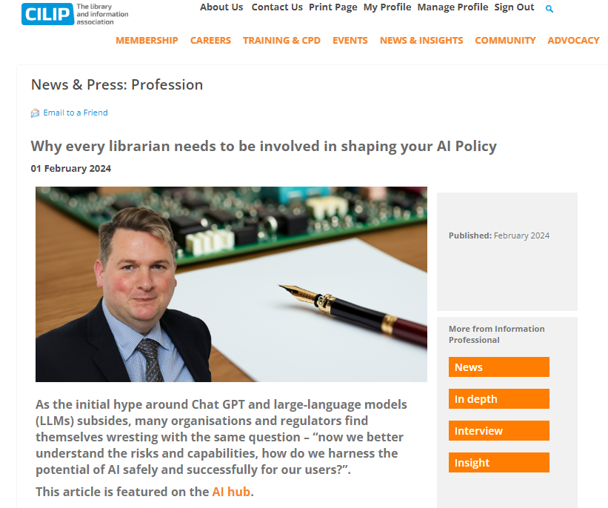
Thought Starter:
How can you get involved in shaping future AI policy in your organisation? (CILIP, 2024)
Notes:
How can you get involved in shaping future AI policy in your organisation? (CILIP, 2024)
https://www.cilip.org.uk/news/news.asp?id=663916

Slide 44
Know
5. Be a Curious Consumer
Digest continuous content about AI uses cases, tools, technologies, applications and impacts to build your knowledge
Notes:
Be a Curious Consumer
Digest continuous content about AI uses cases, tools, technologies, applications and impacts to build your knowledge.

Slide 45
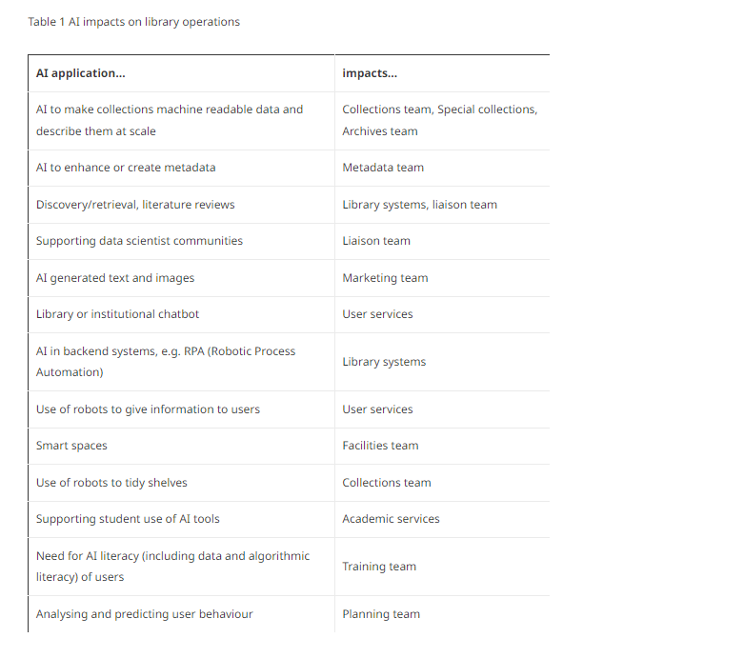
Thought Starter:
How can you explore AI impacts on library operations? (IFLA, 2024)
Notes:
How can you explore AI impacts on library operations? (IFLA, 2024)
https://www.ifla.org/g/ai/developing-a-library-strategic-response-to-artificial-intelligence/

Slide 46
Know
6. Be a Courageous Creator
Leverage your new AI knowledge to create content that adds value and helps deliver positive business impact
Notes:
Be a Courageous Creator
Leverage your new AI knowledge to create content that adds value and helps deliver positive business impact

Slide 47
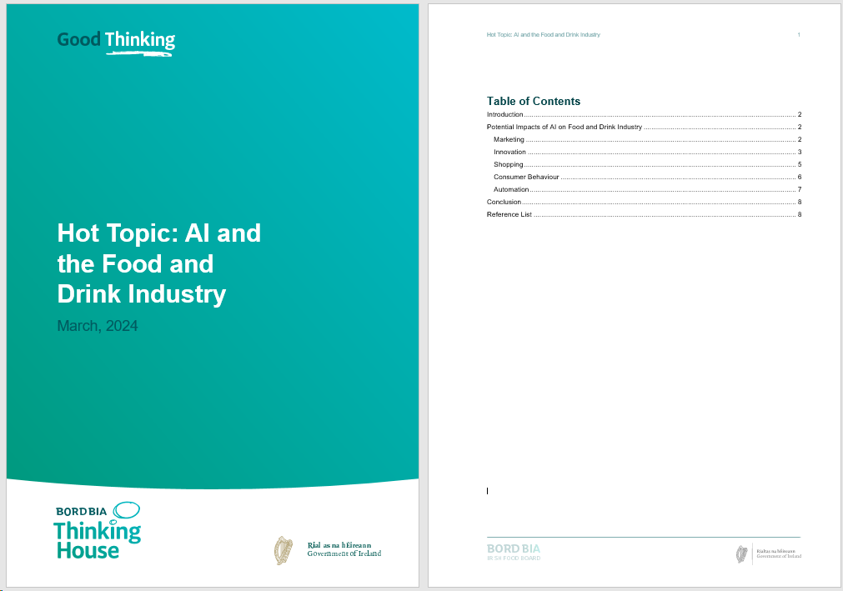
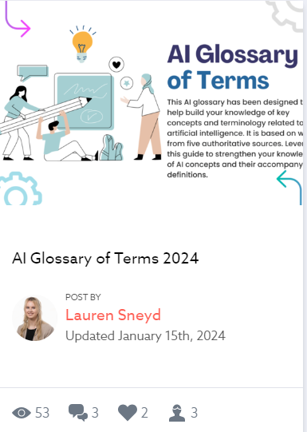
Thought Starter:
How can you create new content that has a positive impact on your users? (Bord Bia, 2024)
Notes:
How can you create new content that has a positive impact on your users? (Bord Bia, 2024)

Slide 48
Grow
7. Be a Driving Force
Align your AI efforts with your organisation’s vision for the future
Notes:
Be a Driving Force
Align your AI efforts with your organisation’s vision for the future.

Slide 49
Thought Starter:
How can you ensure your AI efforts align with your organisation's vision?
Our Vision
Customers around the globe recognise that Irish food and drink is world-class; that it is high quality, distinctive, and made by a diverse range of creative producers from a unique and fortuitous island location.
Notes:
How can you ensure your AI efforts align with your organisation's vision?

Slide 50
Grow
8. Be a Proud Champion
Align your AI innovations with your organisations purpose and values for a human-centric culture and sustainable growth
Notes:
Be a Proud Champion
Align your AI innovations with your organisations purpose and values for a human-centric culture and sustainable growth

Slide 51
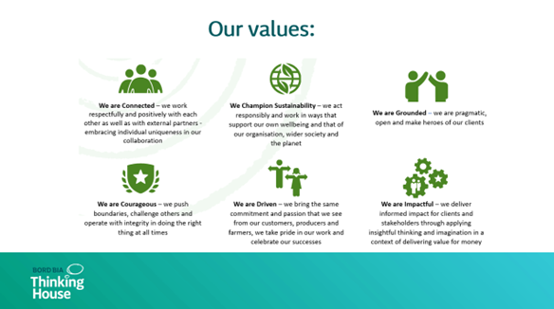
Thought Starter:
How can you ensure your values manifest in your AI activities and help fulfil your organisation’s purpose?
Our Purpose
Our purpose is to bring Ireland’s outstanding food, drink and horticulture to the world, thus enabling growth and sustainability of producers.
Notes:
How can you ensure your values manifest in your AI activities and help fulfil your organisation’s purpose?

Slide 52
Grow
9. Be a Strategic Thinker
Ensure everything you do with AI helps deliver your organisation’s strategy, if it doesn’t you shouldn’t be doing it!
Notes:
Be a Strategic Thinker
Ensure everything you do with AI helps deliver your organisation’s strategy, if it doesn’t you shouldn’t be doing it!

Slide 53
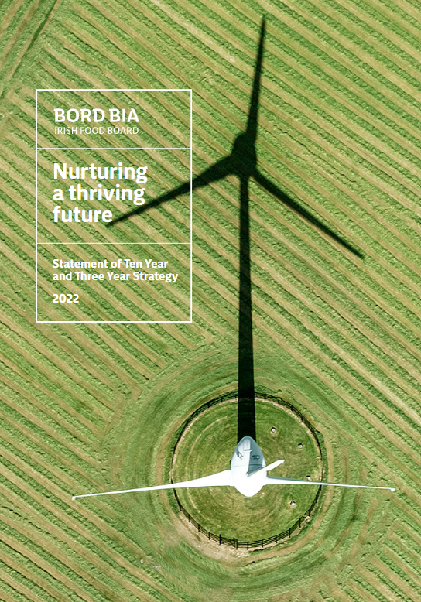
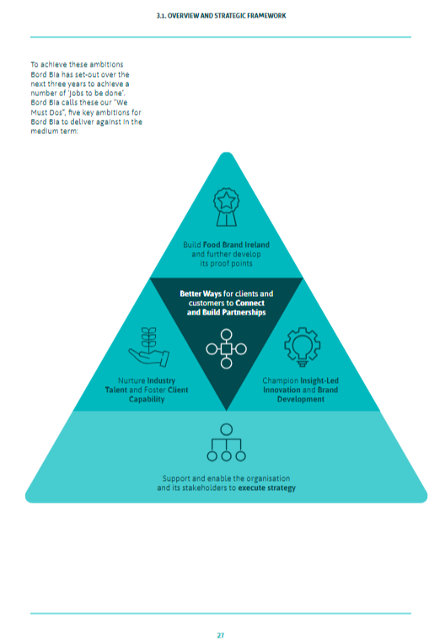
Thought Starter:
How can you develop AI use cases and instructions that empower and enable your organisation to execute strategy? (Bord Bia, 2022)
Notes:
How can you develop AI use cases and instructions that empower and enable your organisation to execute strategy? (Bord Bia, 2022)

Slide 54
10. Be a Critical Experimenter
There’s no time to start like the present, so research AI use cases for your library, and start to play with it. But always critically evaluate the outputs and only ever use AI tools that are approved by your organisation.
Notes:
Be an Experimenter
There’s no time to start like now, so roll up your sleeves, get your hands dirty and start to play with ai but always critically evaluate its outputs and only ever use tools that are approved by your organisation

Slide 55
Thought Starter:
How can you communicate and collaborate with AI to generate effective prompts that help deliver the marketing outputs you need faster?
5 tips for creating effective prompts: (Woods, R, 2023)
1.Create context: Tell the AI what you want it to act as/roleplay:
E.g. I want you to act as a Library marketer
2. Be specific and give the AI a more concrete task at hand:
E.g. You will be responsible for writing engaging and informative social media captions for our library collections on our xxxx LinkedIn page. You will write in our brand tone of voice which is approachable, confident, encouraging and straightforward.
3. Give clear instructions for what you expect in return: E.g. My first request is I need a caption for our collection of authoritative reports on AI in the food industry
4. Give examples of content the AI should take inspiration from: e.g. Read a Linkedin post from the xxxxx Library which promotes their collections and use that as inspiration for your output.
5. Be simple and concise with your language as possible;
And if you find your post is too wordy, you can ask the AI to re-write your prompt to be more concise: e.g. Rewrite the following to be more precise (include your prompt here)
Notes:
How can you communicate and collaborate with AI to generate effective prompts that help deliver the outputs you need faster?
https://www.linkedin.com/learning-login/share?account=78541522&forceAccount=false&redirect=https%3A%2F%2Fwww.linkedin.com%2Flearning%2Fnano-tips-for-using-chatgpt-for-business-with-rachel-woods%3Ftrk%3Dshare_ent_url%26shareId%3Dwk0JEl44RL6FwYj%252BpwEguQ%253D%253D

Slide 56
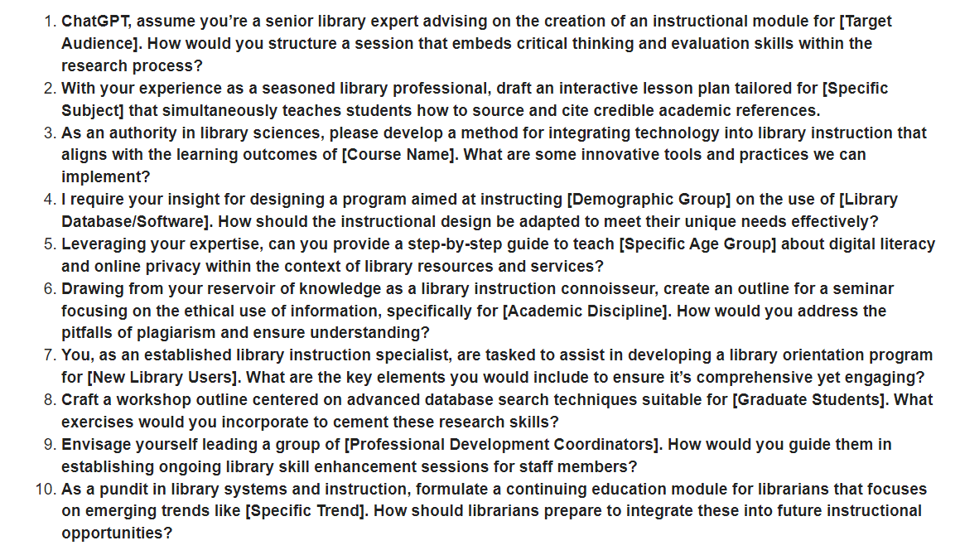
Thought Starter:
How can you communicate and collaborate with AI to generate effective prompts that help deliver the instructional outputs you need faster? (Hogonext, 2024)
Notes:
How can you communicate and collaborate with AI to generate effective prompts that help deliver the outputs you need faster? (Hogonext, 2024)
https://www.printfriendly.com/p/g/GL3BrR

Slide 57

“The only skill that will be important in the 21st century is the skill of learning new skills. Everything else will become obsolete over time.” – Peter Drucker
Notes:
“The only skill that will be important in the 21st century is the skill of learning new skills. Everything else will become obsolete over time.” – Peter Drucker

Slide 58
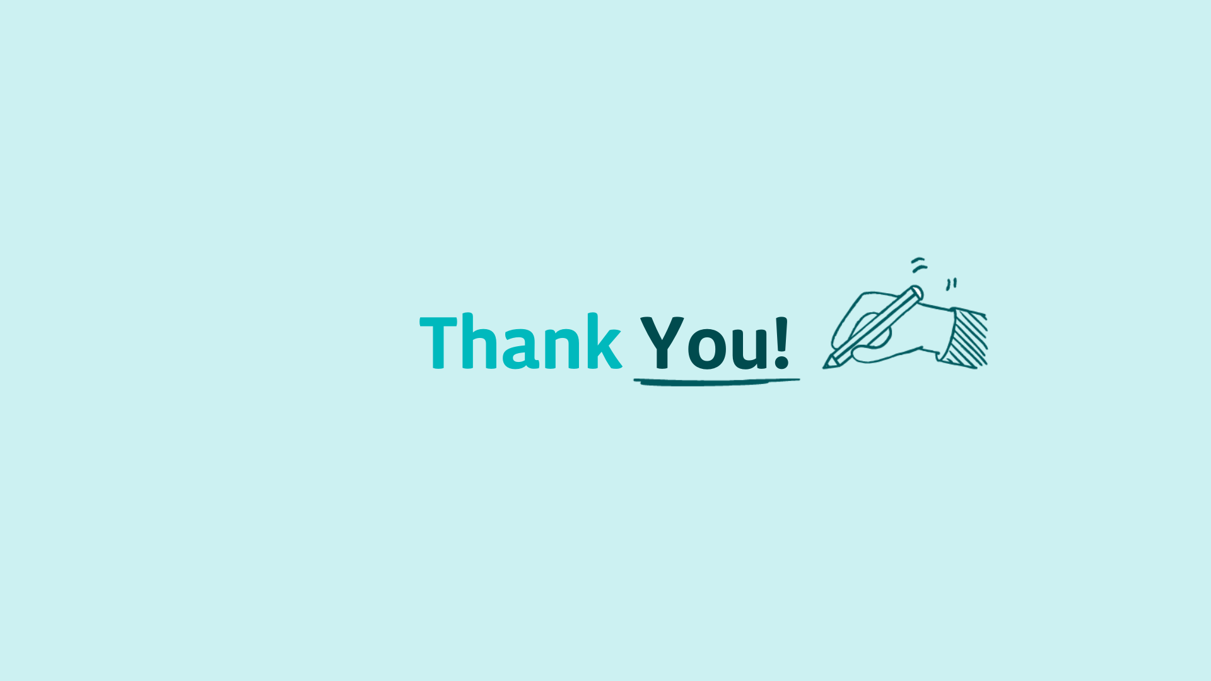

Slide 59




Mairéad McKeown
Manager Knowledge & Critical Capability,
Bord Bia – The Irish Food Board
Lauren Sneyd
Library Assistant & Information Specialist,
Bord Bia – The Irish Food Board
Mairéad.McKeown@BordBia.ie
Lauren.Sneyd@BordBia.ie
LinkedIn
LinkedIn
Notes:
Contact Details

Slide 60
References AI at the Bord Bia Library
Brodnitz, D. (2024). The Most In-Demand Skills for 2024. [online] linkedin.com. Available at: https://www.linkedin.com/business/talent/blog/talent-strategy/linkedin-most-in-demand-hard-and-soft-skills?src=bl-po [Accessed 5 Mar. 2024].
IFLA. (2023). Developing a library strategic response to Artificial Intelligence. [online] Available at: https://www.ifla.org/g/ai/developing-a-library-strategic-response-to-artificial-intelligence/.
Johnson, B. (2023). How to Use Generative AI for Real Work. Shutterstock.
Long, D. and Magerko, B. (2020). What is AI Literacy? Competencies and Design Considerations. Proceedings of the 2020 CHI Conference on Human Factors in Computing Systems. doi:https://doi.org/10.1145/3313831.3376727.
McGettigan, L. (2023). AI THE LIBRARY AND DISRUPTION! [online] Solus UK Ltd. Available at: https://wp.sol.us/ai-the-library-and-disruption/ [Accessed 5 Mar. 2024].
Seyhan Demirdag, P. (2023). Generative AI is a tool in service of humanity - What Is Generative AI? Video Tutorial . [online] LinkedIn. Available at: https://www.linkedin.com/learning/what-is-generative-ai/generative-ai-is-a-tool-in-service-of-humanity?u=78541522 [Accessed 5 Mar. 2024].

Slide 61
References Top Tips Resources
Brodnitz, D. (2023). The Most In-Demand Hard and Soft Skills of 2020. [online] www.linkedin.com. Available at: https://www.linkedin.com/business/talent/blog/talent-strategy/linkedin-most-in-demand-hard-and-soft-skills [Accessed 5 Mar. 2024].
cilip.org.uk. (2024). Why every librarian needs to be involved in shaping your AI Policy. [online] Available at: https://www.cilip.org.uk/news/news.asp?id=663916 [Accessed 5 Mar. 2024].
Hogonext. (2024). 10 powerful ChatGPT prompts for Library Instruction - HogoNext. [online] Available at: https://hogonext.com/10-powerful-chatgpt-prompts-for-library-instruction/ [Accessed 5 Mar. 2024].
IFLA. (n.d.). Developing a library strategic response to Artificial Intelligence. [online] Available at: https://www.ifla.org/g/ai/developing-a-library-strategic-response-to-artificial-intelligence/ [Accessed 5 Mar. 2024].
Woods, R. (2024). Nano Tips for Using ChatGPT for Business with Rachel Woods . [online] Linkedin.com. Available at: https://www.linkedin.com/learninglogin/share?account=78541522&forceAccount=false&redirect=https%3A%2F%2Fwww.linkedin.com%2Flearning%2Fnano-tips-for-using-chatgpt-for-business-with-rachel-woods%3Ftrk%3Dshare_ent_url%26shareId%3Dwk0JEl44RL6FwYj%252BpwEguQ%253D%253D [Accessed 5 Mar. 2024].
www.linkedin.com. (2024). Conquer AI in 2024 With 5 Free Courses. [online] Available at: https://www.linkedin.com/pulse/conquer-ai-2024-5-free-courses-apolloitservices-quswc/ [Accessed 5 Mar. 2024].
www.mckinsey.com. (2022). How to communicate better. [online] Available at: https://www.mckinsey.com/featured-insights/mckinsey-guide-to-managing-yourself/how-to-communicate-better [Accessed 5 Mar. 2024].

