Slide 1
FIRST YEAR OF THE HSLG LITERATURE SEARCH PEER REVIEW BUDDY SCHEME
Breeda Herlihy
Mercy University Hospital Library

Slide 2
OVERVIEW
Additional training and support for systematic reviews consistently requested by HSLG members
Many HSLG members are solo-librarians without peers to call on for shared expertise
Networking opportunities can be limited by constraints of solo-librarianship
Increased demand for support with systematic reviews from students

Slide 3
Groups of 2 or 3 share their own search strategy for a literature search
Review strategies with PRESS guidelines as a guide
Meet online to discuss
Based on Yorkshire and Humber Health Libraries & Knowledge Network (YOHHLNet) Lit Search Peer Review Buddy Scheme
ROUND 1
Groups of 3 assigned a research question from Systematic Search Practice Sets
Each member devises a search
Each member shares their strategy
Meet online to discuss
Based on OER resources provided by Taubman Health Library, University of Michigan
ROUND 2

Slide 4
PARTICIPANTS
ROUND 1
ROUND 2
DEC
FEB
JULY
JAN
JUNE
SUMMER 2023
WINTER 2023/4
15
21

Slide 5
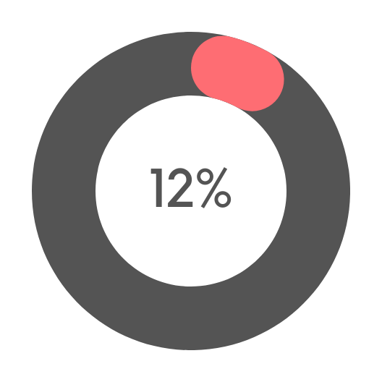
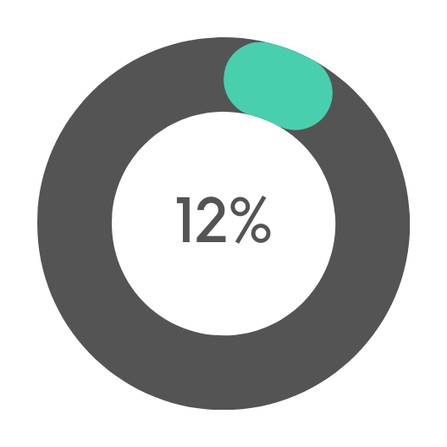
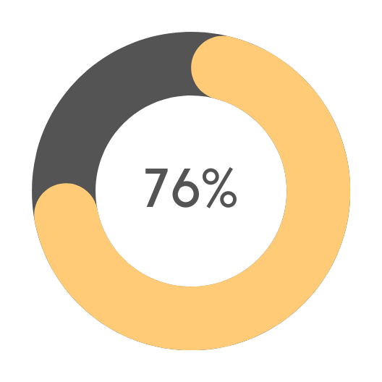
EXPERIENCE WITH LITERATURE SEARCHING
LESS THAN 1 YEAR
1-3 YEARS
MORE THAN 3 YEARS

Slide 6
DISCIPLINE WHERE MOST SEARCHES CONDUCTED
BUSINESS
SOCIAL SCIENCES
FOOD SCIENCE
EDUCATION
HEALTH SCIENCES

Slide 7
RESOURCES
USED

Slide 8
OVERALL, WE FOUND THE MEETING WITH OUR PEERS AS PART OF THIS SCHEME TO BE:
MODERATELY
VERY
EXTREMELY
Feedback survey response rate:
52% Round 1
47% Round 2
USEFUL
INTERESTING
RELEVANT

Slide 9
WHAT WENT WELL?
OPPORTUNITY TO NETWORK
NEW LEARNING
EXCHANGING EXPERTISE & EXPERIENCE
It was a good challenge. Our search was a bit tricky so we had to keep changing our strings to capture all the articles. It was comforting to know that we were all in the same boat and interesting that we had similar but not identical approaches. So we all learned something new.
DISCUSSION

Slide 10
WHAT COULD WE DO TO IMPROVE THE SCHEME?
EXPERT GUIDANCE
REPEAT
Perhaps some form of professional moderation, as my colleague said 'it was a bit like the blind leading the blind'. We felt we needed an expert to tell us what we got right or wrong.
SUPPORT DOCUMENTATION
SHARED
RESEARCH
QUESTION

Slide 11
WHAT, IF ANYTHING, WILL YOU DO DIFFERENTLY AS A RESULT OF THE PEER REVIEW MEETING?
BROADEN
SEARCHES
PEER REVIEW
MY SEARCHES
INVESTIGATE DATABASE FEATURES
It has given me more awareness that there is no perfect search, the value of similar citation searching and to maybe ask for peer support in the future
MODIFY MY
SEARCH PROCESS

Slide 12
NEXT STEPS
Round 3
Further training opportunities to be co-ordinated by HSLG
Additional resources on HSLG website

Slide 13
THANK YOU
www.hslg.ie

