Slide 1
TARCiS
(Terminology, Application, and Reporting of Citation Searching)
Louise Farragher, Ailish Farragher, Caitríona Lee, Niall O’Brien

Slide 2
Outline
Guidance on terminology, application, and reporting of citation searching: the TARCiS statement
Tools
  Google Scholar
  Dimensions.ai
  Lens database via Citation Chaser

Slide 3
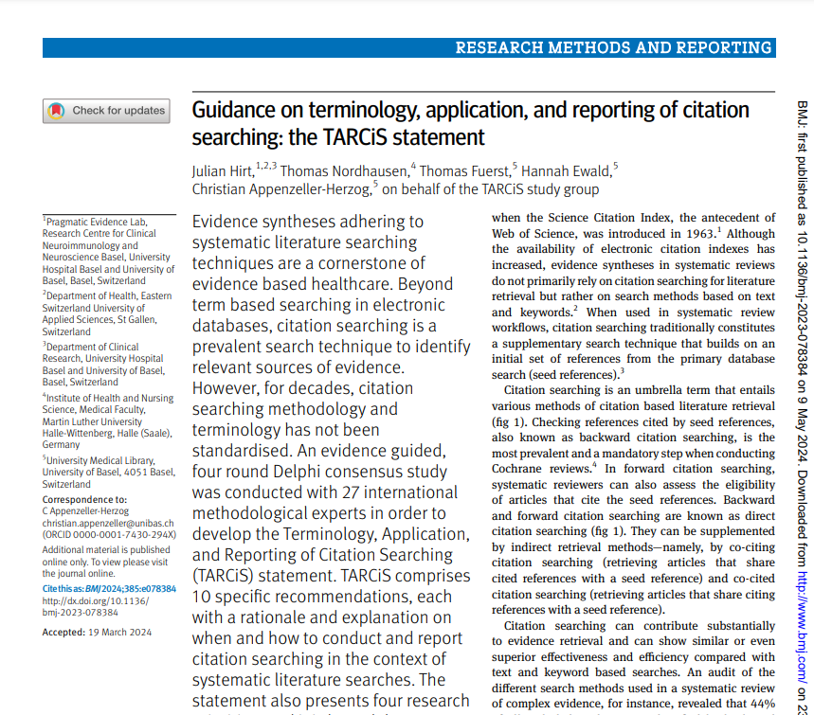

Slide 4
TARCiS (Terminology, Application, and Reporting of Citation Searching)
Hirt J, Nordhausen T, Fuerst T, Ewald H, Appenzeller-Herzog C; TARCiS study group. Guidance on terminology, application, and reporting of citation searching: the TARCiS statement. BMJ. 2024 May 9;385:e078384. doi: 10.1136/bmj-2023-078384
Evidence syntheses adhering to systematic literature searching
techniques are a cornerstone of evidence based healthcare. Beyond
term based searching in electronic databases, citation searching is a
prevalent search technique to identify relevant sources of evidence.

Slide 5
TARCiS Statement - 3 Key points
The TARCiS statement provides guidance in which contexts citation searching is likely to be beneficial for systematic reviewers
10 specific recommendations on when and how to conduct citation searching and how to report it in the context of systematic literature searches, and also frames four research priorities
The statement will contribute to a unified terminology, systematic application, and transparent reporting of citation searching and support those who are conducting or assessing citation searching methods

Slide 6


Methods
A scoping review of the methodological literature
A multistage online Delphi study.
The Delphi technique is a well-established approach to answering a research question through the identification of a consensus view across subject experts. It allows for reflection among participants, who are able to nuance and reconsider their opinion based on the anonymised opinions of others. However, researchers must take steps to enhance robustness of the studies. It is important to try and prevent participants from simply resorting to agreeing with the majority view; studies must also predefine what is meant by ‘consensus’ and how it will be established.

Slide 7
Methods
A scoping review of the methodological literature
A multistage online Delphi study.
The Delphi technique is a well-established approach to answering a research question through the identification of a consensus view across subject experts. It allows for reflection among participants, who are able to nuance and reconsider their opinion based on the anonymised opinions of others. However, researchers must take steps to enhance robustness of the studies. It is important to try and prevent participants from simply resorting to agreeing with the majority view; studies must also predefine what is meant by ‘consensus’ and how it will be established.
Notes:
The Delphi technique was first developed in the 1950s by Norman Dalkey and Olaf Helmer in an attempt to gain reliable expert consensus

Slide 8
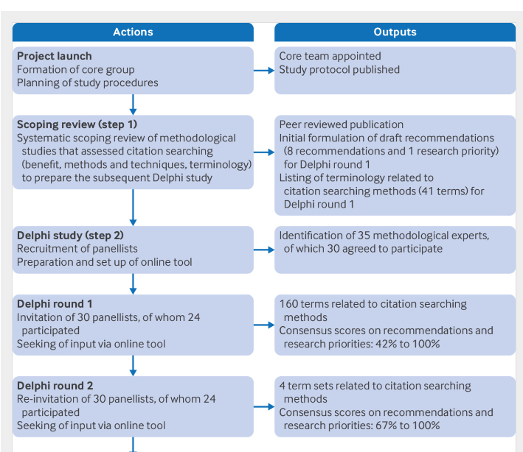

Slide 9
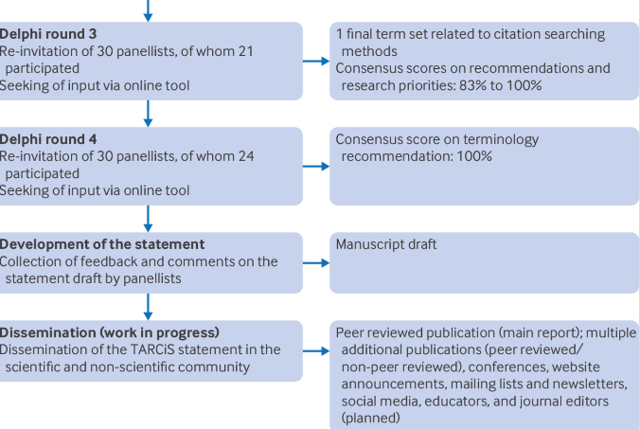

Slide 10
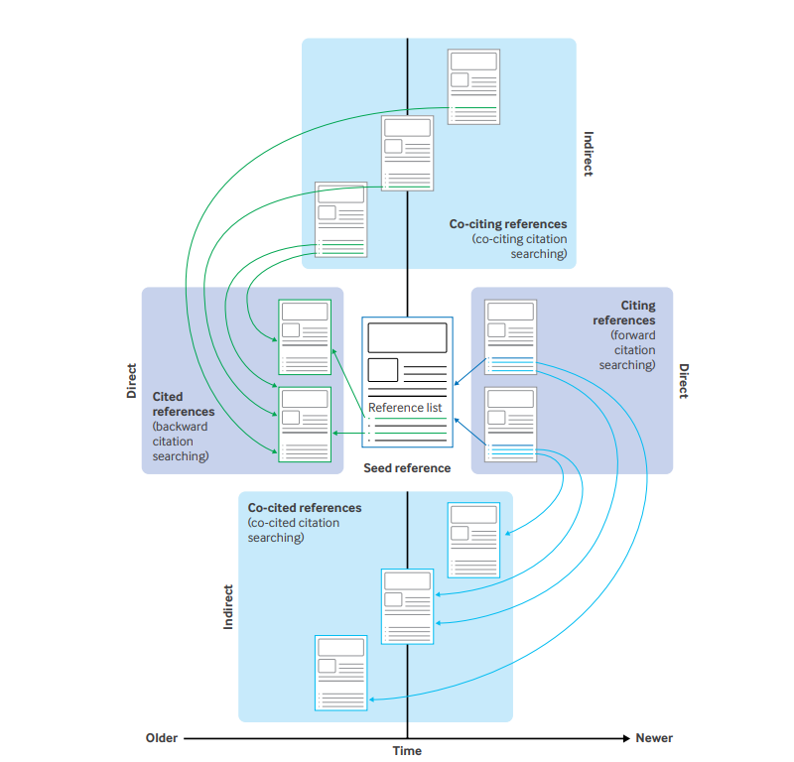

Slide 11
TARCiS 10 recommendations

Slide 12
1. The following terminology should be used to describe search methods that exploit citation relationships:
“Citation searching” as an umbrella term.
“Backward citation searching” to describe the sub-method retrieving and screening cited references.
“Forward citation searching” to describe the sub-method retrieving and screening citing references.
“Reference list checking” to describe the sub-method retrieving and screening cited references by manually reviewing reference lists.

Slide 13
1. The following terminology should be used to describe search methods that exploit citation relationships (cntd):
“Co-citing citation searching” to describe the sub-method retrieving and screening co-citing references.
“Iterative citation searching” to describe one or more repetition(s) of a search method that exploits citation relationships.
“Seed references” to describe relevant articles that are known beforehand and used as a starting point for any citation search.

Slide 14
TARCiS 10 recommendations
For systematic search topics that are difficult to search for, backward and forward citation searching should be seriously considered as supplementary search techniques.
For systematic search topics that are easier to search for and addressed by a highly sensitive search, backward and forward citation searching are not explicitly recommended as supplementary search techniques. Reference list checking of included records can be used to confirm the sensitivity of the search strategy.

Slide 15
TARCiS 10 recommendations
Backward and forward citation searching as supplementary search techniques should be based on all included records of the primary search (ie, all records that meet the inclusion criteria of the review after full text screening of the primary search results). Occasionally, it can be justified to deviate from this recommendation and either use further pertinent records as additional seed references or only a defined sample of the included records.
Backward citation searching should ideally be conducted by screening the titles and abstracts of the seed references as provided by a citation index. Screening titles as provided when checking reference lists of the seed references can still be performed.

Slide 16
TARCiS 10 recommendations
Using the combined coverage of two citation indexes for citation searching to achieve more extensive coverage should be considered if access is available. This combination is especially meaningful if seed references cannot be found in one index and reference lists were not checked.
Before screening, the results of supplementary backward and forward citation searching should be deduplicated.
If citation searching finds additional eligible records, another iteration of citation searching should be considered using these records as new seed references.

Slide 17
TARCiS 10 recommendations
Standalone citation searching should not be used for literature searches that aim at completeness of recall.

Slide 18
10. Reporting of citation searching should clearly state:
the seed references (along with a justification should the seed references differ from the set of included records from the results of the primary database search),
the directionality of searching (backward, forward, co-cited, co-citing),
the date(s) of searching (which might differ between rounds of iterative citation searching) (not applicable for reference list checking),
the number of citation searching iterations (and possibly the reason for stopping if the last iteration still retrieved additional eligible records),

Slide 19
all citation indexes searched (eg, Lens.org, Google Scholar, Scopus, citation indexes in Web of Science) and, if applicable, the tools that were used to access them (eg, Publish or Perish, citationchaser),
if applicable, information about the deduplication process (eg, manual/automated, the software or tool used),
the method of screening (ie, state whether the records were screened in the same way as the primary search results or, if not, describe the alternative method used), and
the number of citation searching results in the right column box of the PRISMA 2020 flow diagram for new or updated systematic reviews that included searches of databases, registers, and other sources.

Slide 20
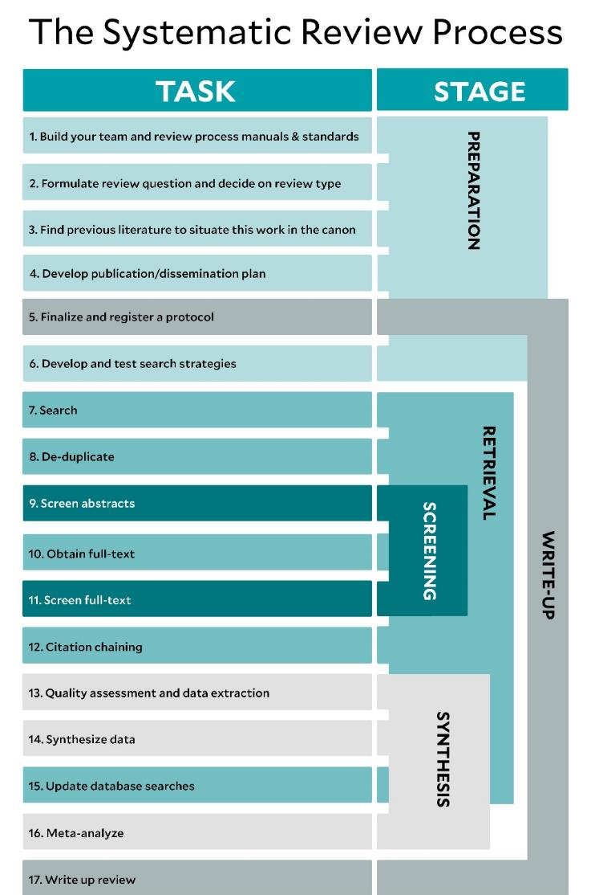
Citation searching:
When?
Citation searching of seed papers
Citation searching of included studies
Source: Yale Medical Library

Slide 21
Sources & Tools

Slide 22
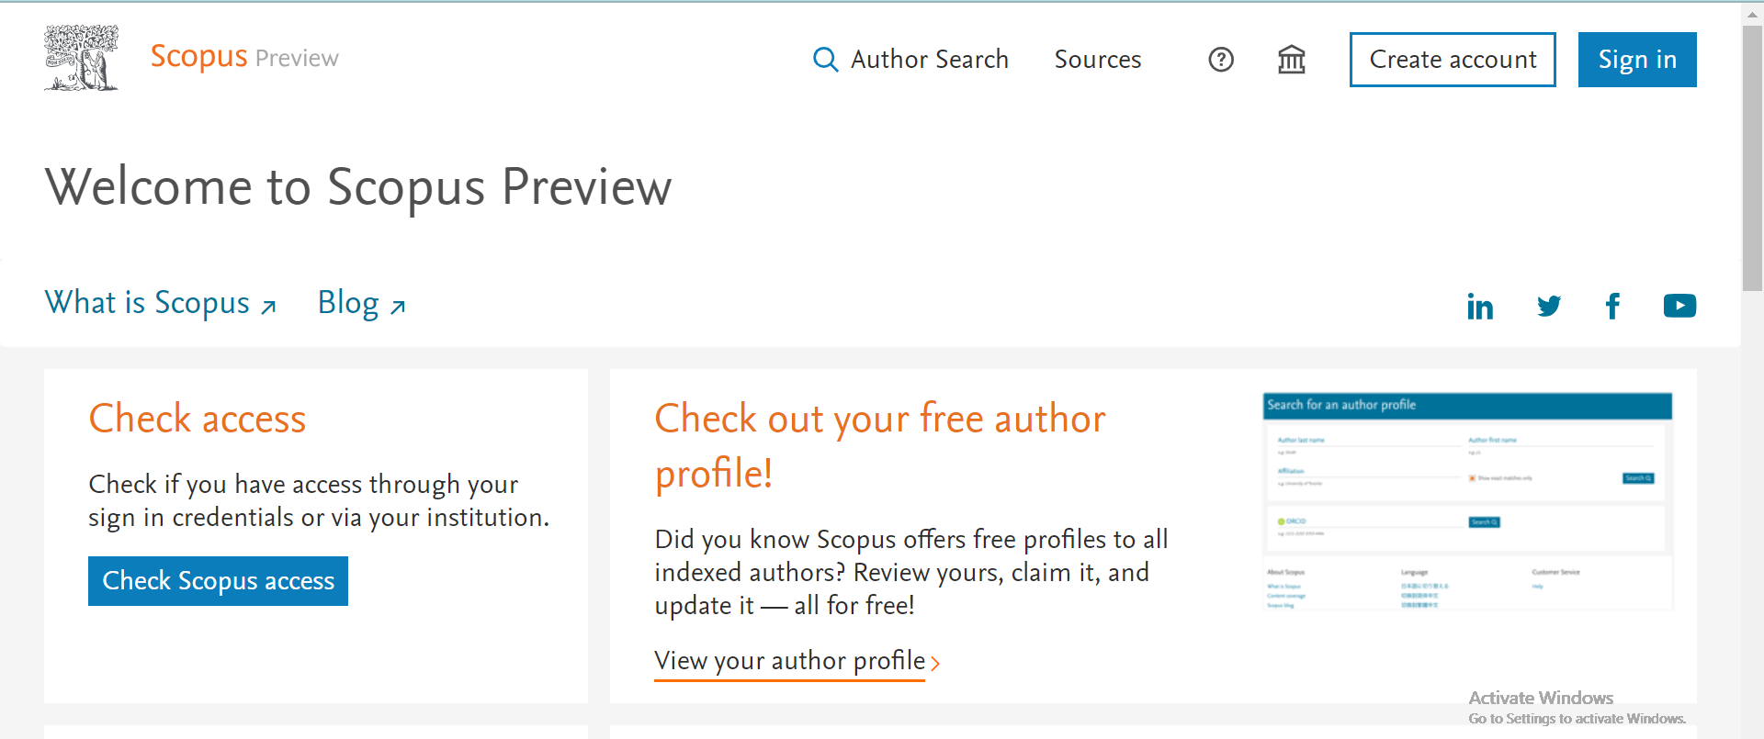
Scopus
Scopus,
citation indexes in Web of Science

Slide 23
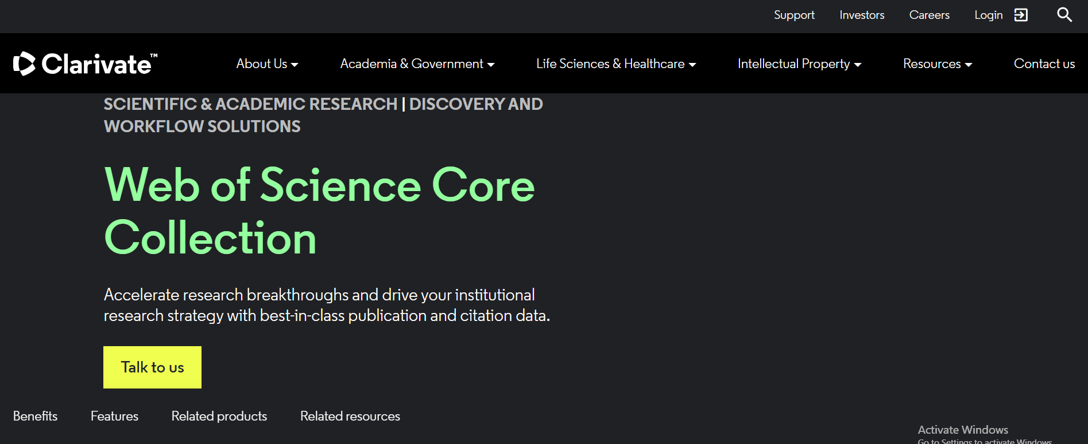
Web of Science

Slide 24
Freely available citation indexes
Google Scholar (free to use)
Dimensions.ai (free and paid version available)
Lens.org with Citation Chaser (free and paid version available)

Slide 25
Example
Glass ionomer cements as fissure sealing materials: yes or no?: A systematic review and meta-analysis (2018)
47 References
10.1016/j.adaj.2018.02.001

Slide 26
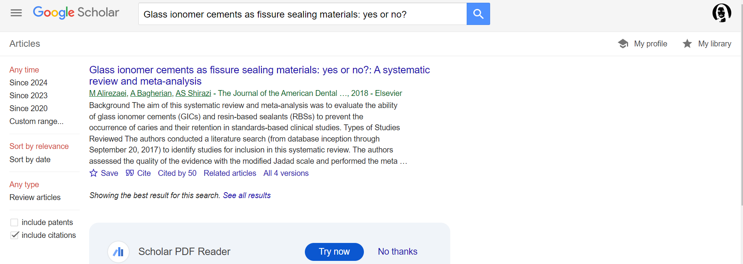
Google Scholar (forward citation searching only)
Notes:
forward citation searching only
Cumbersome unless you use a third party tool like Publish or Perish

Slide 27
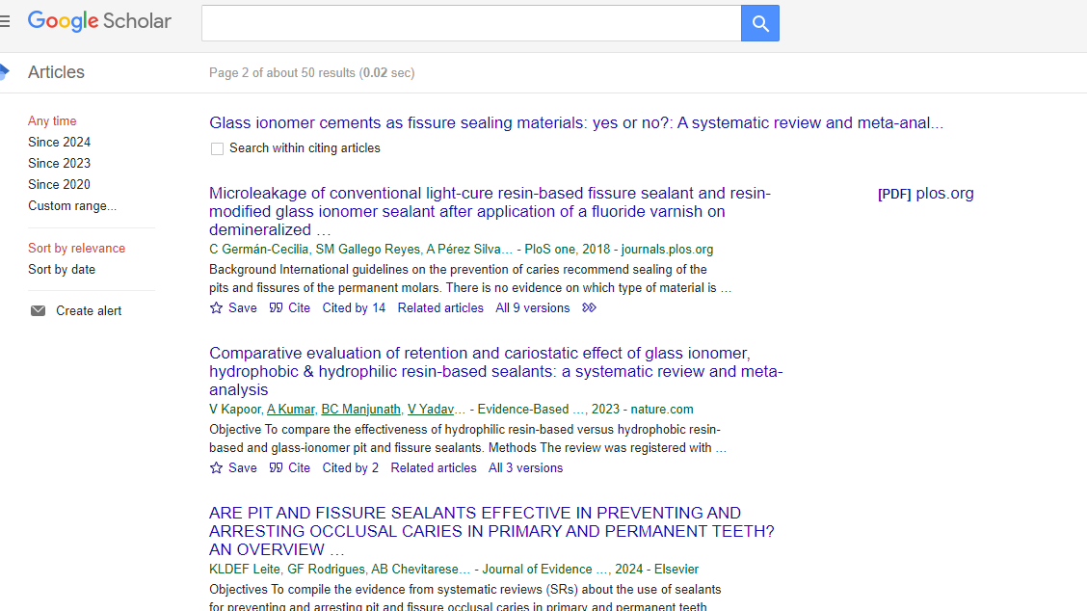

Slide 28
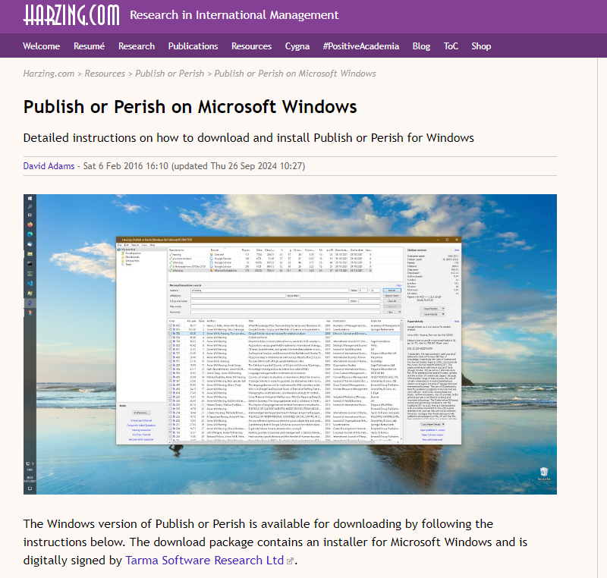
Google scholar & Publish or Perish v8

Slide 29
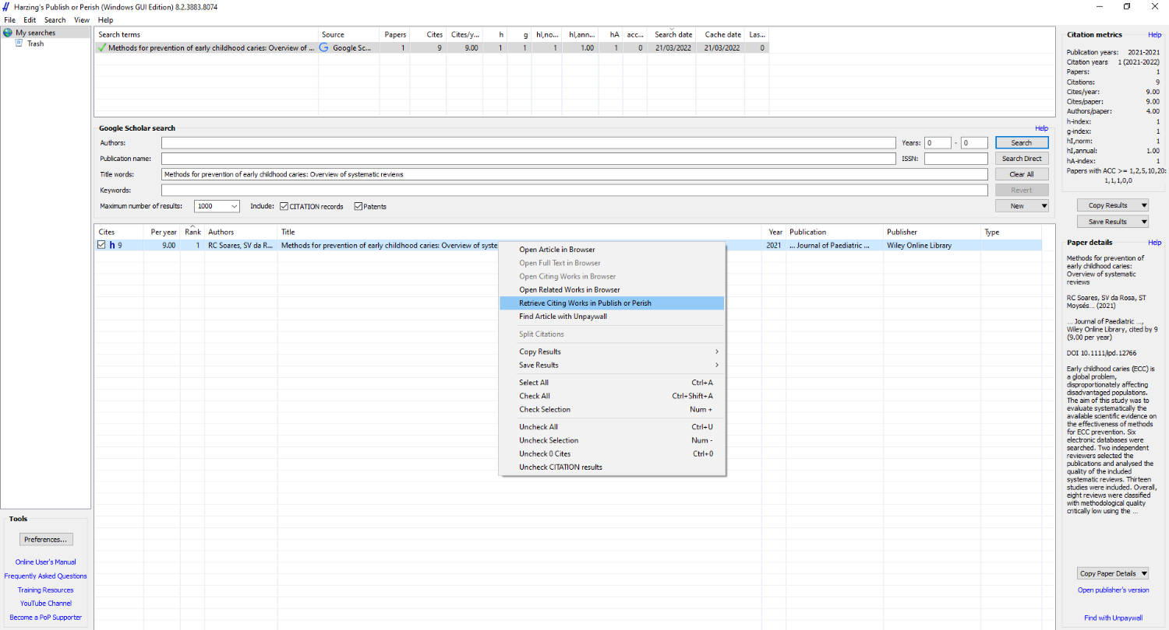

Slide 30
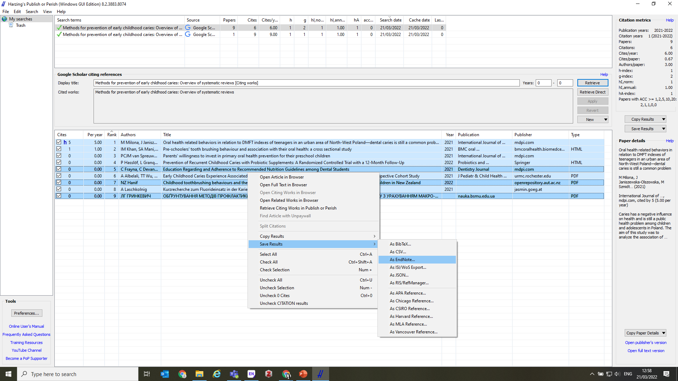
Notes:
Download the references and import into your reference manager

Slide 31
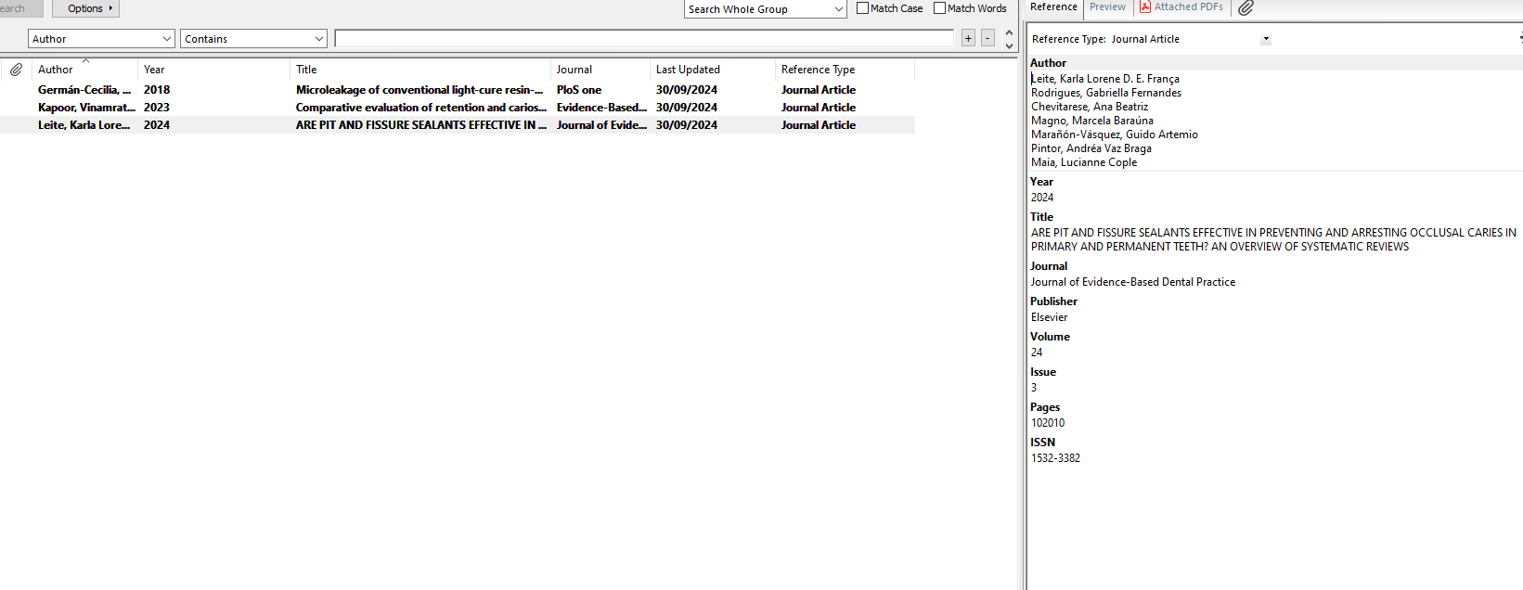
Google Scholar – no abstracts!

Slide 32

Dimensions.ai

Slide 33
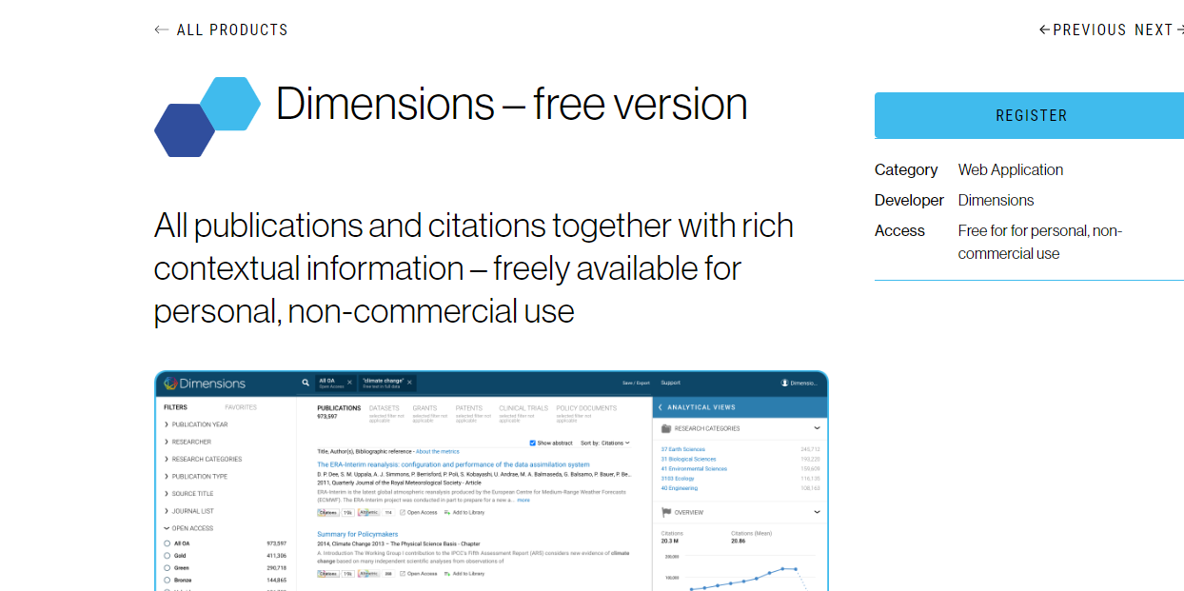
Dimensions.ai

Slide 34
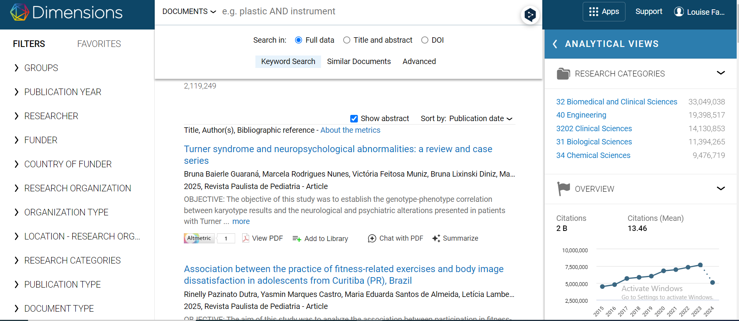

Slide 35
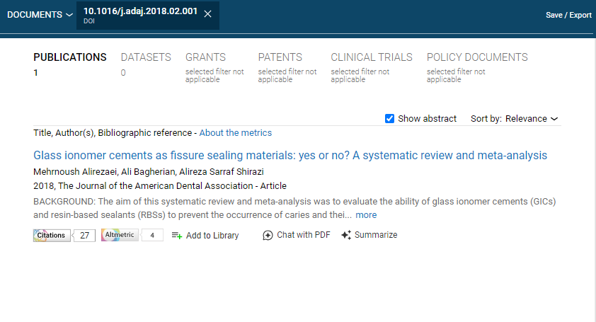

Slide 36
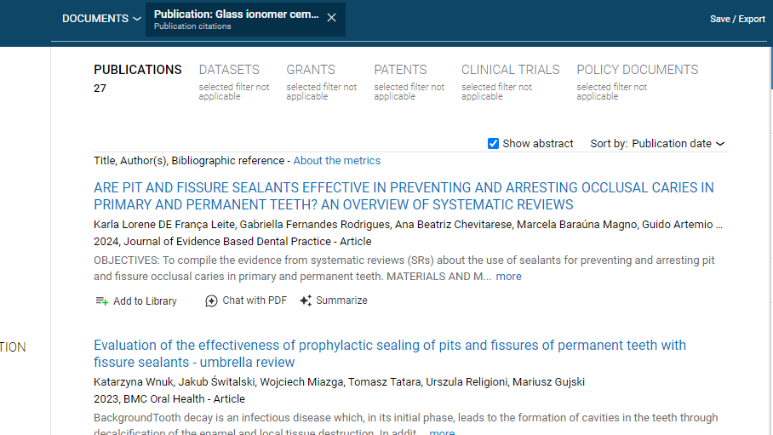

Slide 37
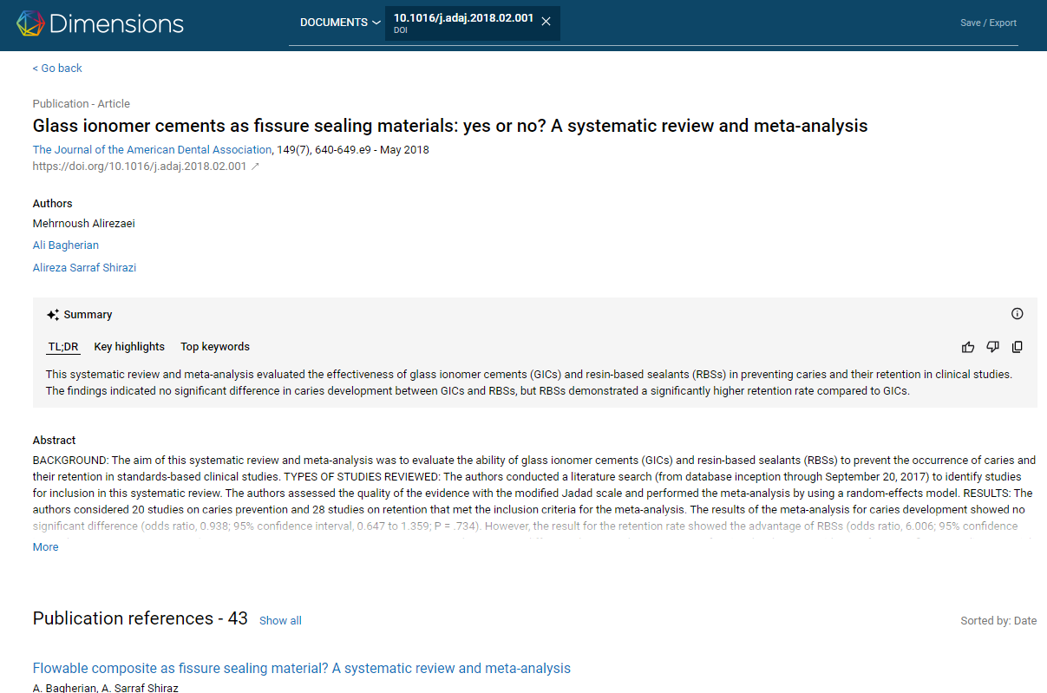

Slide 38
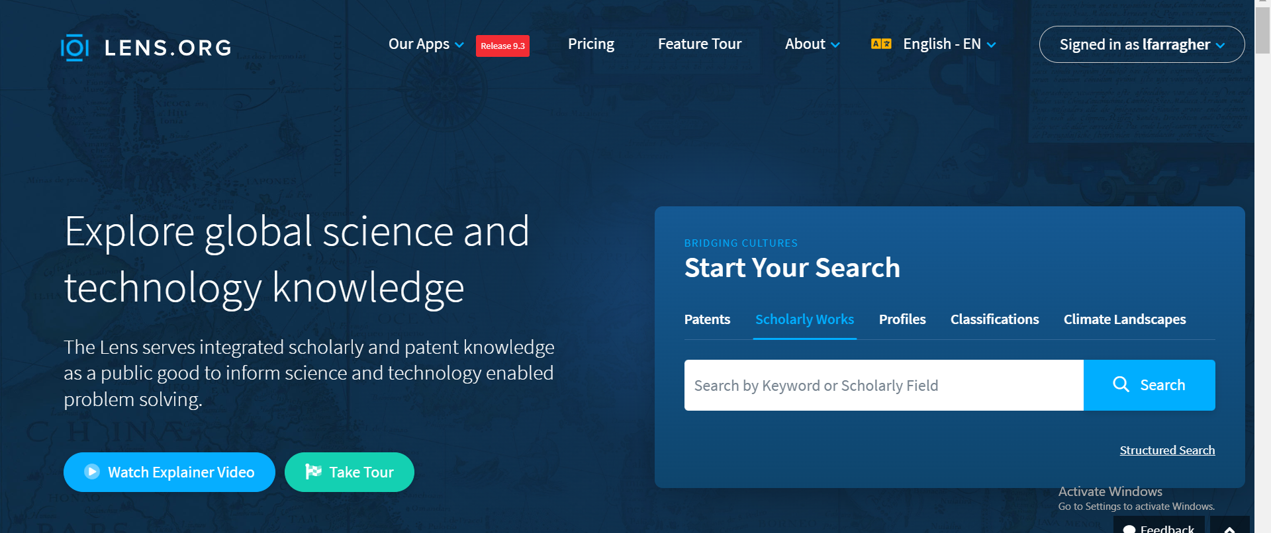
Lens.org
Notes:
Go to the Lens.org website

Slide 39
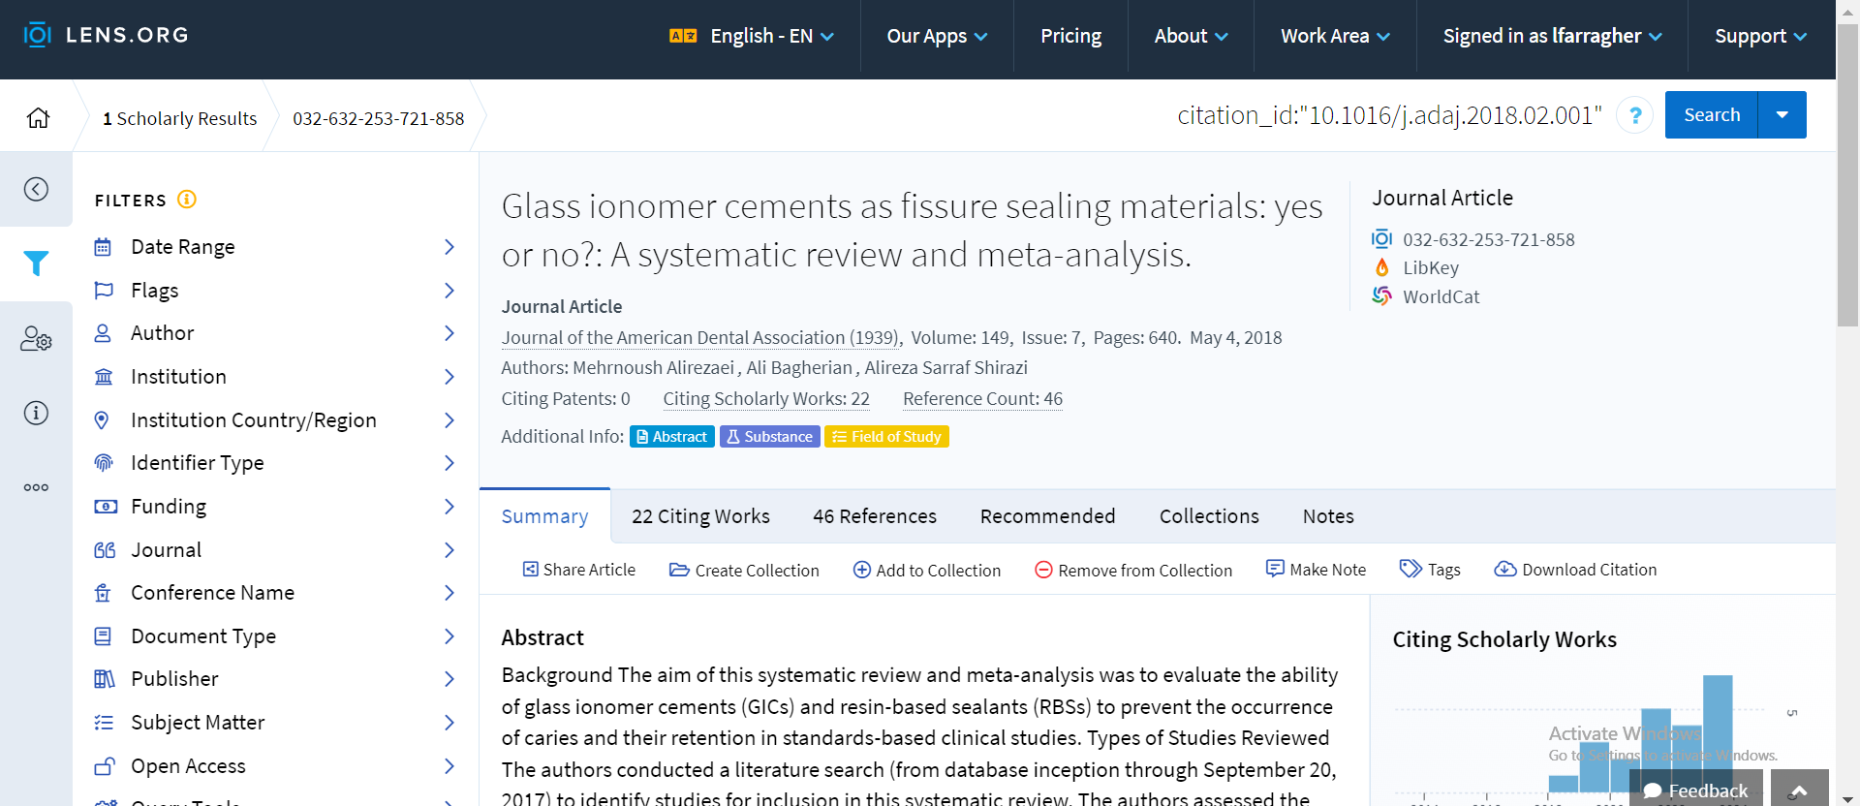
Lens.org

Slide 40
Lens database & Citation chaser
Citation Chaser: https://estech.shinyapps.io/citationchaser/

Slide 41
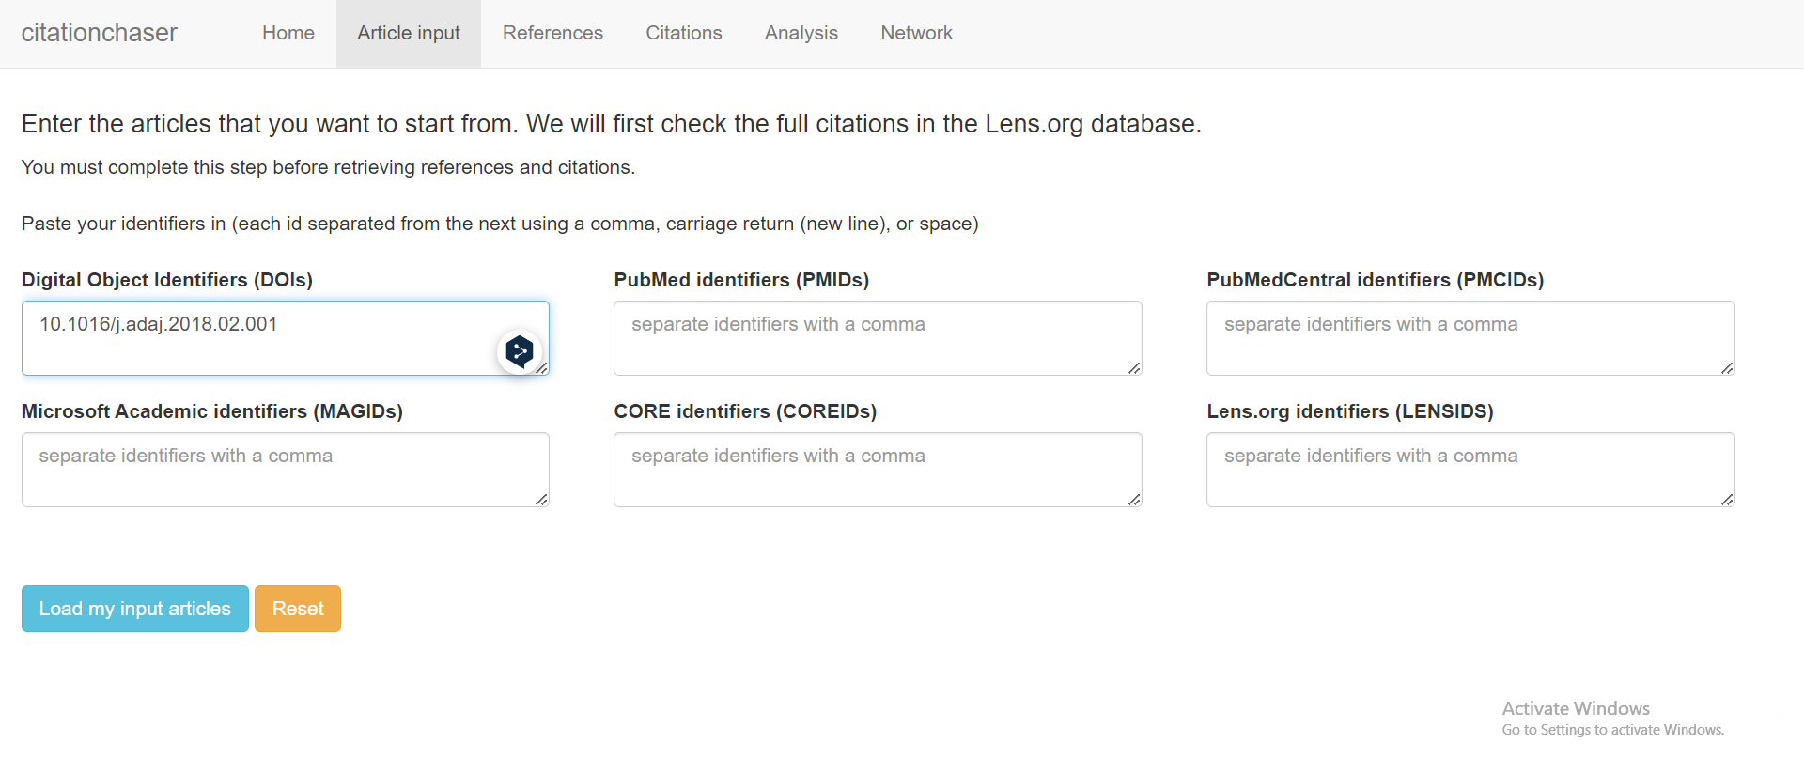

Slide 42
Comparisons
 | Google Scholar | Dimensions.ai | Lens.org
Abstracts | No | Yes | Yes
Related articles | Yes | Yes | Yes
Citations & references? | Citating references only | Yes | Yes
Has an export function? | Cumbersome. Use Publish or Perish | Yes | Somewhat cumbersome. Use Citation Chaser
Coverage | Good esp for grey lit and non-English citations | ? | ?

Slide 43
Deduplication of citation searching results
Don’t forget to deduplicate your set of references
Don’t forget to deduplicate your set of references against the original set of database results, that have already been screened!

Slide 44
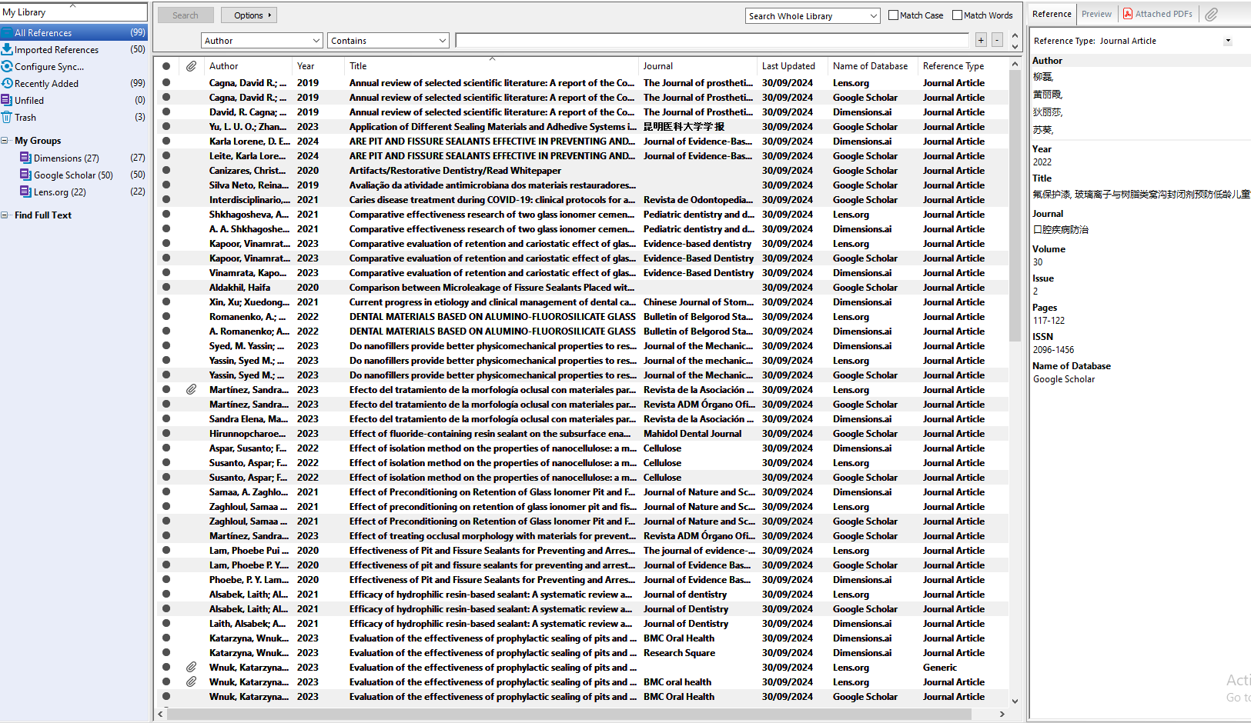

Slide 45
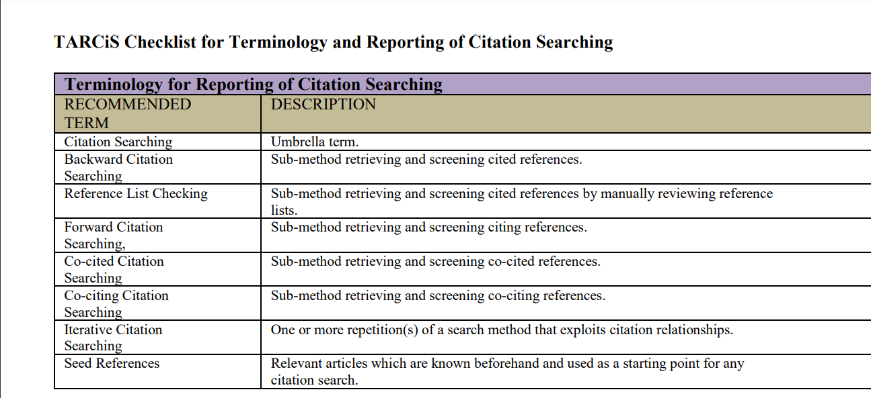
TARCiS Checklist

Slide 46
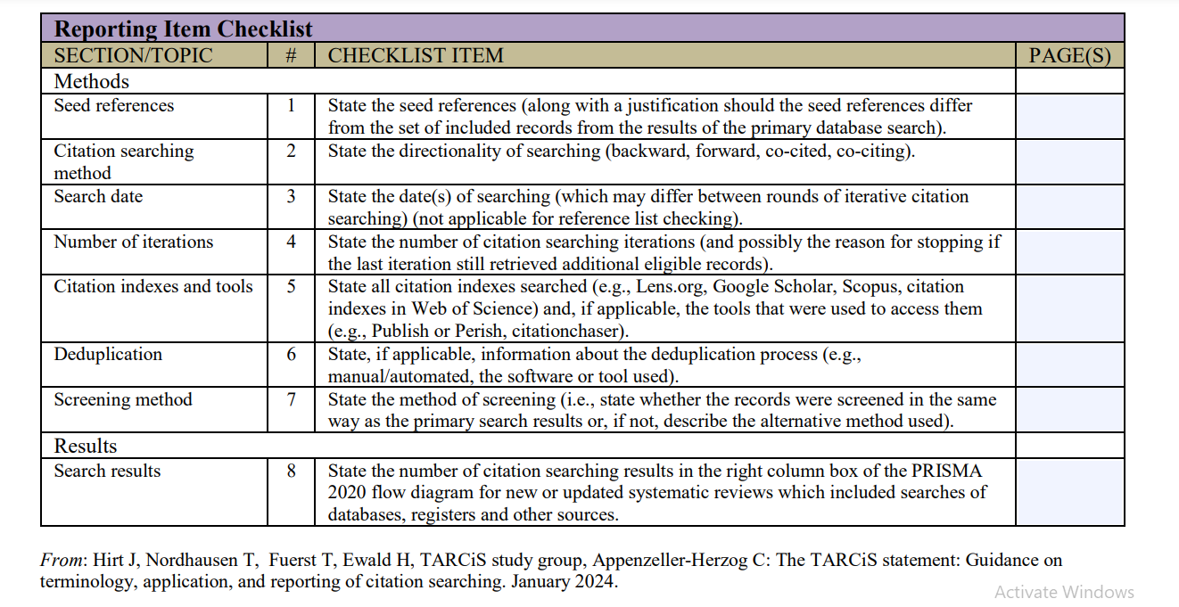

Slide 47
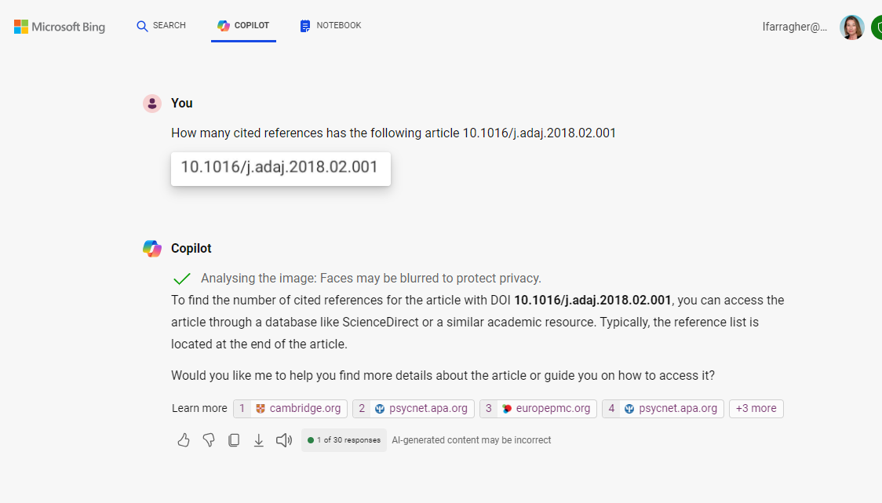
Can AI chatbots help?

Slide 48
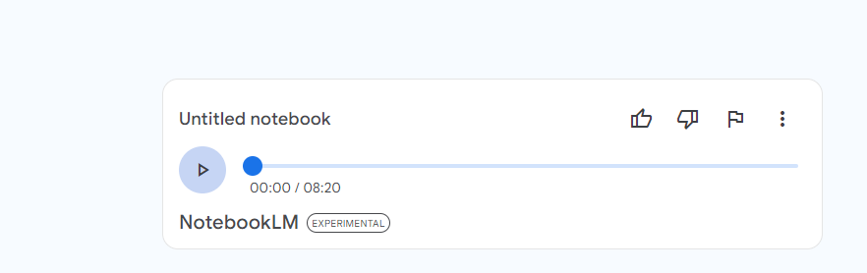
A Google Notebook LM summary of TARCiS
https://notebooklm.google.com/notebook/93042f2f-4d58-484b-b947-436509192185/audio
Summarised in 8 minutes!

